Slide 1
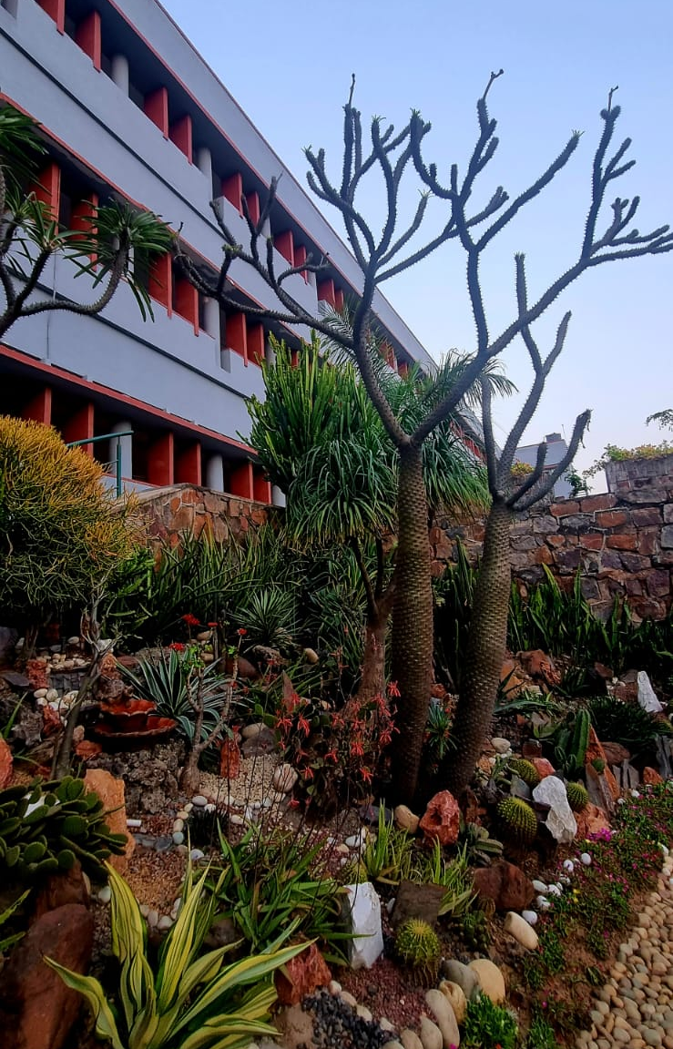
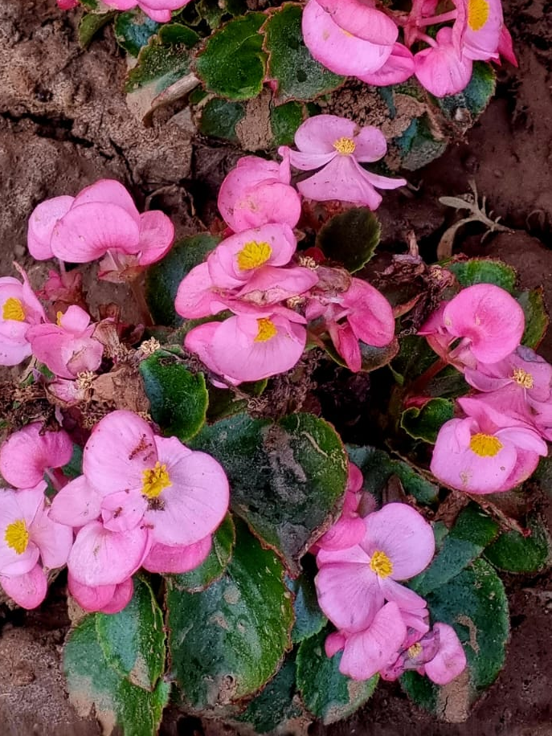
Janki Devi Memorial College
(University of Delhi)
Ornamental Plants At JDMC

Slide 2
R
Tagetes Patula
Janki Devi Memorial College
(University of Delhi)
Botanical name : Tagetes P.
English name : French Marigold
Hindi name : गेंदा फूल
Usage: Tagetes is used for all kinds of skin conditions, Contusions, Bruises and Varicose veins. Minor skin injuries and inflammation can also be successfully treated. Marigold ointment promotes wound healing for eczema and sunburn.
Source : Google
Picture Courtesy: Prof. Swati Pal
Faculty- Tara N.
Students- Shikha, Neetu, Archana

Slide 3
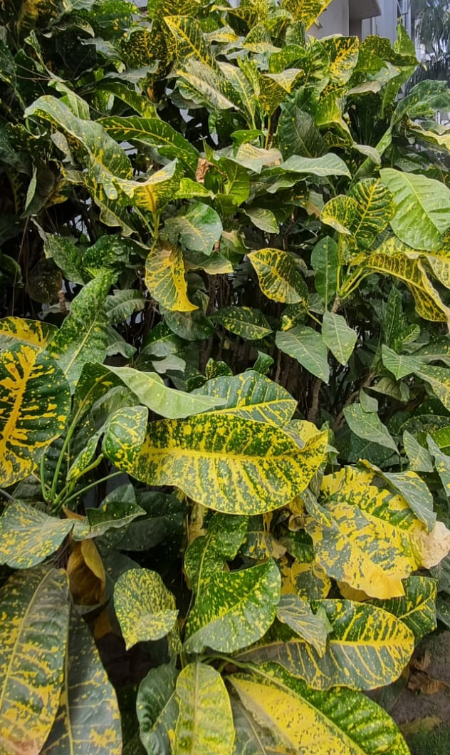
Janki Devi Memorial College
(University of Delhi)
Codiaeum Variegatum
Botanical name : Codiaeum Variegatum
English name: Garden Croton
Hindi name : क्रोटन प्लांट
Usage : The aqueous leaf extracts or decoctions of this plant are used in traditional medicine to treat amoebic dysentery and stomach ache.
Source- Wikipedia
Picture courtesy- JDMC Gardens
Faculty- Tara N.
Students- Shikha, Neetu, Archana

Slide 4
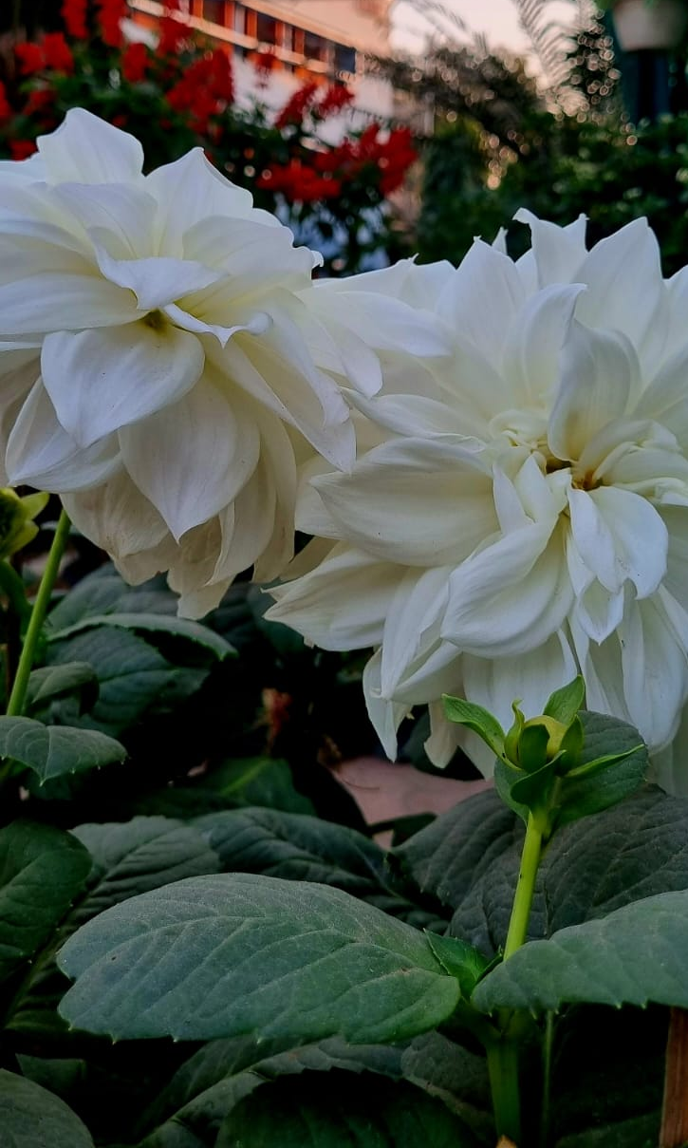
Janki Devi Memorial College
(University of Delhi)
Dahila Pinnata
Botanical name : Dahlia Pinnata
English name: Garden Dahlia
Hindi name: डेलिया
Usage : It is an herb which is used to treat epilepsy, skin problems such as rashes, cracks and soothe tired feet.
Source- Wikipedia
Picture courtesy- JDMC Gardens
Faculty -Tara N.
Students- Shikha, Neetu, Archana

Slide 5
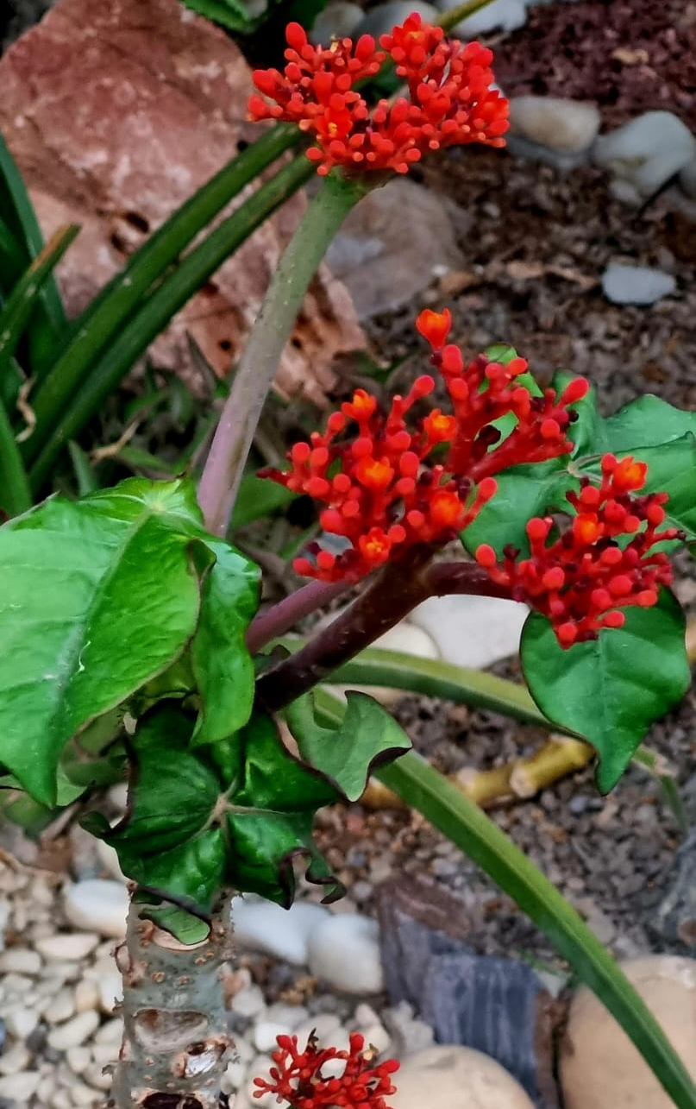
Janki Devi Memorial College
(University of Delhi)
Jatropha Podagrica
Botanical name : Jatropha Podagrica
English name : Jatropha Curcas
Hindi name : गौतेमाला रूबाब
Usage : In folk medicine it is used as an analgesic , tonic, aphrodisiac, purgative, laxatives, and to treat infections, intestinal worms, snakebite & gout.
Source- Wikipedia
picture courtesy- JDMC Gardens
Faculty - Tara N.
Students- Shikha, Neetu, Archana

Slide 6
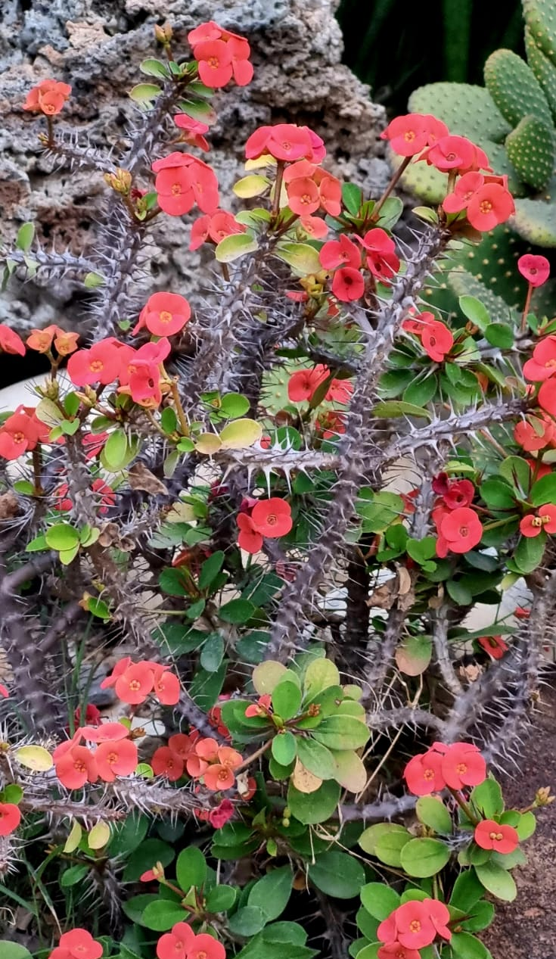
Janki Devi Memorial College
(University of Delhi)
Euphorbia Mili
Botanical name: Euphorbia Milii
English name : Crown-Of- Thorns
Hindi name :कांटो का ताज
Usage : The Chinese use it as a cure for cancer, and some Brazilians believe that it can cure warts.
Source- Wikipedia
Picture courtesy- JDMC Gardens
Faculty - Tara N.
Students- Shikha, Neetu, Archana

Slide 7
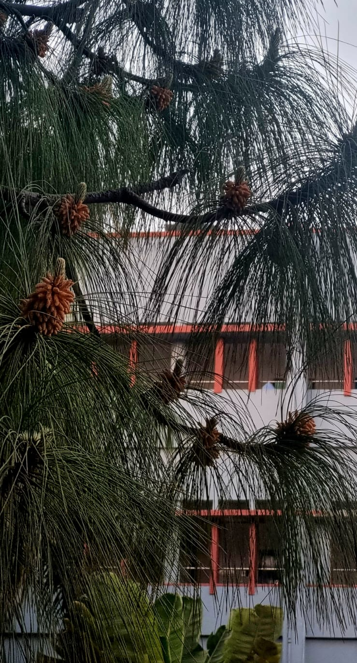
Janki Devi Memorial College
(University of Delhi)
Pinus Devoniana
Botanical name : Pinus Devoniana
English name : Michoacán Pine
Hindi name : चीड़ का पेड़
Usage : It is used internally for kidney and bladder issues. Also
as a rub, and in a steam bath to treat rheumatic conditions,
and for the respiratory system.
Source- Wikipedia
Picture courtesy- JDMC Gardens
Faculty - Tara N.
Students- Shikha, Neetu, Archana

Slide 8
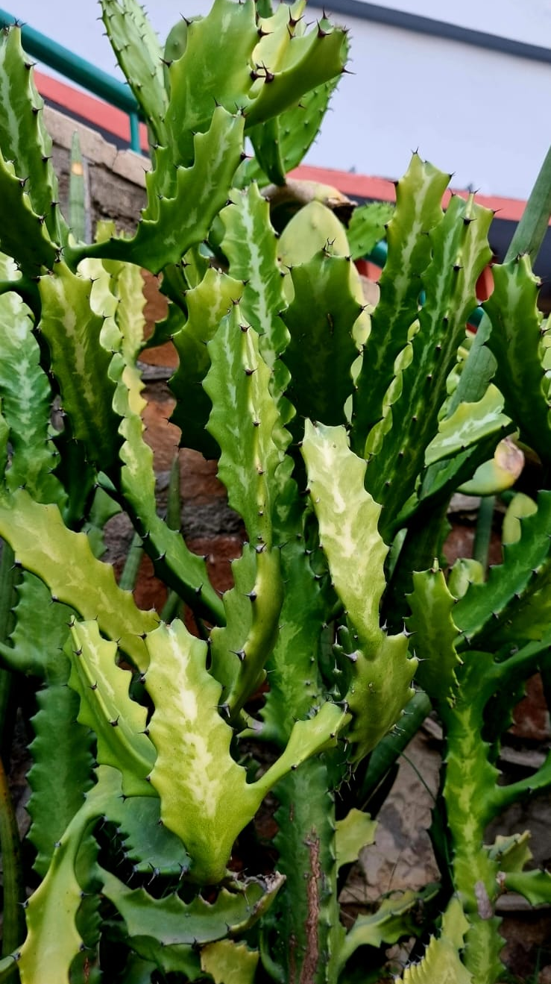
Janki Devi Memorial College
(University of Delhi)
Euphorbia Ingens
Botanical name : Euphorbia Ingens
English name : Euphorbiaceae
Hindi name : कांटो का मुकुट
Usage : The milky latex of the tree is exceedingly dangerous and can render both humans and animals blind, produce severe skin rashes, and poison them when swallowed.
Source- Wikipedia
Picture courtesy- JDMC Garden
Faculty - Tara N.
Students- Shikha, Neetu, Archana

Slide 9
Janki Devi Memorial College
(University of Delhi)
Beaucarnea Recurvata
Botanical name : Beaucarnea Recurvata
English name: Ponytail Palm
Hindi name :चुटिया पाम
Usage : This wonderful houseplant was named one of the best plants for air purification by NASA.
Toxic gases are broken down so that one can breathe clean air.
Source- Wikipedia
Picture courtesy- JDMC Gardens
Faculty - Tara N.
Students- Shikha, Neetu, Archana

Slide 10
Janki Devi Memorial College
(University of Delhi)
Iberis Sempervirens
Botanical name : Iberis Sempervirens
English name: Evergreen Candytuft
Hindi name: वार्षिक कैंडीट्यूफ्ट
Usage : Candytuft is a bitter-tasting tonic that helps in digestion and relieves wind and bloating, however it is rarely employed in
contemporary herbalism.
Source- Wikipedia
Picture courtesy- Google
Faculty - Tara N.
Students- Shikha, Neetu, Archana

Slide 11
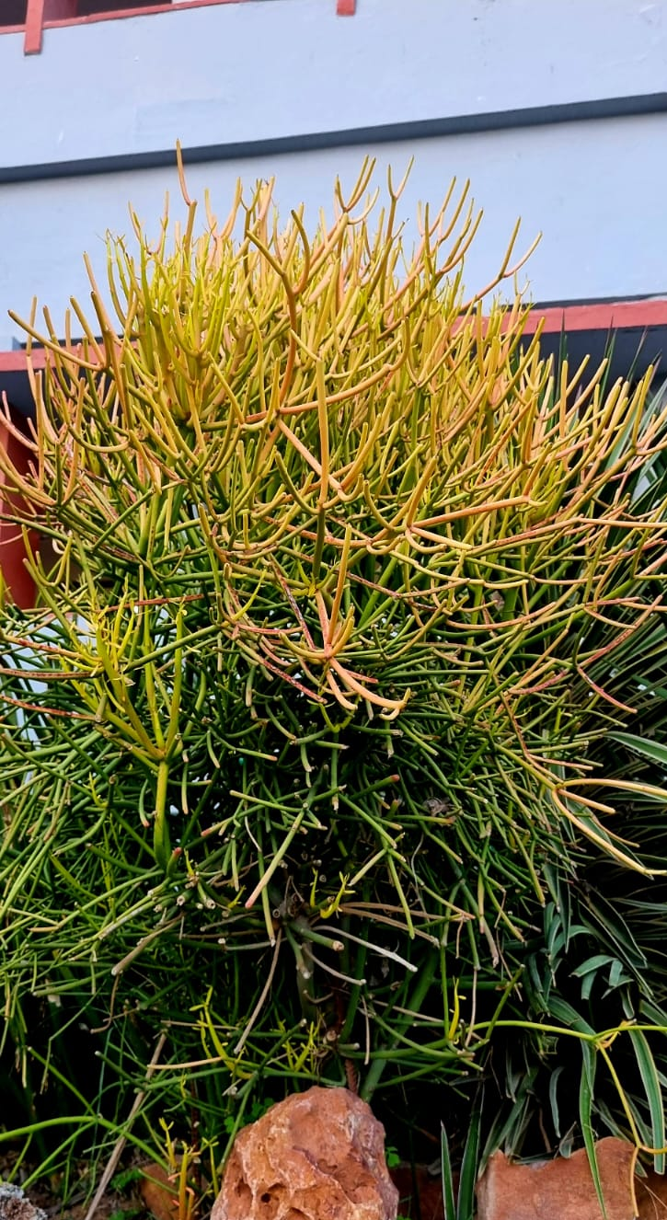
Janki Devi Memorial College
(University of Delhi)
Euphorbia Tirucalli
Botanical name : Euphorbia Tirucalli
English name: Pencil Cactus
Hindi name : पेंसिल कैक्टस
Usage : It causes certain types of cancer to develop, suppresses the immune system, and encourages tumor growth.
Source- Wikipedia
Picture courtesy- JDMC Gardens
Faculty - Tara N.
Students- Shikha, Neetu, Archana

Slide 12
Janki Devi Memorial College
(University of Delhi)
Opuntia Cochenillifera
Botanical name : Opuntia Cochenillifera
English name :Cochineal Nopal Cactus
Hindi name : नागफनी कैक्टीसिया
Usage :In folk medicine, the cladodes and fruits are used to cure fevers and mycoses (fungal skin infections), the flattened stem portions are applied as poultices.
Source- Wikipedia
Picture courtesy- JDMC Gardens
Faculty - Tara N.
Students- Shikha, Neetu, Archana

Slide 13
Papaver Rhoeas
Janki Devi Memorial College
(University of Delhi)
Botanical name – Papaver Rhoeas
English name - Common Poppy
Hindi name – खसखस
Usage - Used for production of dried Latex and Opium.It is the principal precursor of narcotic and analgesic opiates such as Morphine, Heroin and Codeine.
Source: Wikipedia
Picture Courtesy: JDMC Gardens
Faculty - Tara N.
Students- Shikha, Neetu, Archana

Slide 14
Janki Devi Memorial College
(University of Delhi)
Yucca Gloriosa
Botanical name :Yucca Gloriosa
English name : Spanish Dagger
Hindi name : युका कटार
Usage : Yucca can be used to create natural shampoo and soap that is gentle on the skin and aids in the recovery of small cuts and rashes.
Source- Wikipedia
Picture courtesy- JDMC Gardens
Faculty - Tara N.
Students- Shikha, Neetu, Archana

Slide 15
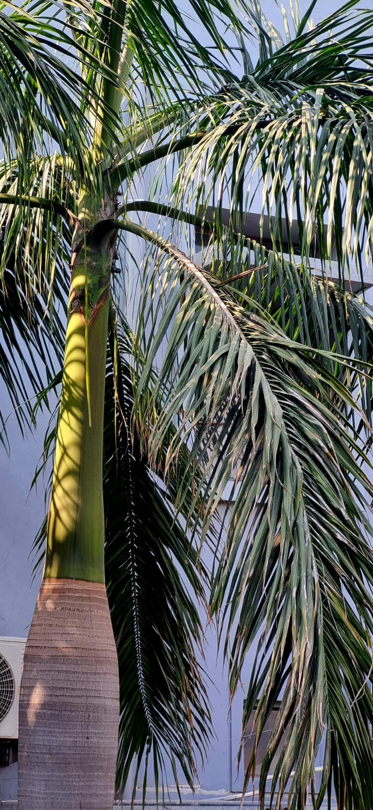
Janki Devi Memorial College
(University of Delhi)
Roystonea Regia
Botanical name : Roystonea Regia English name: Cuban Royal Palm
Hindi name : राजा पाम
Usage : The seed is used as a feed for animals and as a source of oil. Leaves are employed for thatching and for building. As a diuretic, the roots are added to tea, a drink that originated in Haiti, by Cubans of Haitian descent.
Source- Wikipedia
Picture courtesy- JDMC Gardens
Faculty - Tara N.
Students- Shikha, Neetu, Archana

Slide 16
Janki Devi Memorial College
(University of Delhi)
Dracaena Angustifolia
Botanical name : Dracaena Angustifolia
English name: Narrow-Leaf Dragon Tree
Hindi name : संकरी ड्रैगन
Usage : It’s decoction of the leaves is believed to cure dysentery, leucorrhea, and mucus.
Source- Wikipedia
Picture courtesy- JDMC Gardens
Faculty - Tara N.
Students- Shikha, Neetu, Archana

Slide 17
Janki Devi Memorial College
(University of Delhi)
Tecoma stan
Botanical name :Tecoma Stan
English name: Yellow Elder
Hindi name: पीली टेकोमा
Usage : Treats hyperglycemia, gastrointestinal and urinary tract UTI disorders, jaundice toothaches, headaches, colds, skin infections, scorpion, snake, and rat bites.
Source- Wikipedia
Picture courtesy- JDMC Gardens
Faculty - Tara N.
Students- Shikha, Neetu, Archana

Slide 18
Janki Devi Memorial College
(University of Delhi)
Alocasia Macrarhizos
Botanical name : Alocasia Macrarhizos
English name: Colocasia Ghuiyan Aruj
Hindi name :अरबी का पत्ता
Usage : It is used to treat several diseases like diarrhea, constipation, diabetes, and cancer.
Source: Wikipedia
Picture Courtesy JDMC Gardens
Faculty - Tara N.
Students- Shikha, Neetu, Archana

Slide 19
Janki Devi Memorial College
(University of Delhi)
Peace Lily
Botanical name: Spathiphyllum Wallisii
English name : Peace Lily
Hindi name : शांत लिली
Usage : It has air-purifying capabilities as a houseplant; it dissolves and neutralizes toxic gases like carbon monoxide and formaldehyde.
Source: Wikipedia
Pictures Courtesy: Google
Faculty - Tara N
Students- Shikha, Neetu, Archana

Slide 20
Janki Devi Memorial College
(University of Delhi)
Lilium Longiflorum
Botanical name- Lilium Longiflorum
English name- Easter Lily
Hindi name- यूनानी लिली
Usage- This fragrant seasonal plant is extremely poisonous for cats. Eating small amounts of any part of this plant can cause dangerous symptoms and lead to death from kidney failure.
Source- Wikipedia
Picture courtesy- JDMC Gardens
Faculty - Tara N.
Students- Shikha, Neetu, Archana

Slide 21
Janki Devi Memorial College
(University of Delhi)
Deiffenbachia Segiune
Botanical name : Deiffenbachia Segiune
English name : Dumb Cane
Hindi name : डिफिनबिचिया
Usage : Seguine is a popular ornamental with variegated leaves. The sap is used in tropical America as an antidote against snakebites, and to treat rheumatism and gout externally.
Source: Wikipedia
Picture Courtesy: JDMC Gardens
Faculty - Tara N.
Students- Shikha, Neetu, Archana

Slide 22
Janki Devi Memorial College
(University of Delhi)
Hyophorbe Lagenicaulis
Botanical name :Hyophorbe Lagenicaulis
English name : Bottle Palm
Hindi name : बोतल पाम
Usage :It is native to Round Island of Mauritius. It has bulging trunk. Leaves are sparse.
Source: Wikipedia
Picture Courtesy: JDMC Gardens
Faculty - Tara N.
Students- Shikha, Neetu, Archana

Slide 23
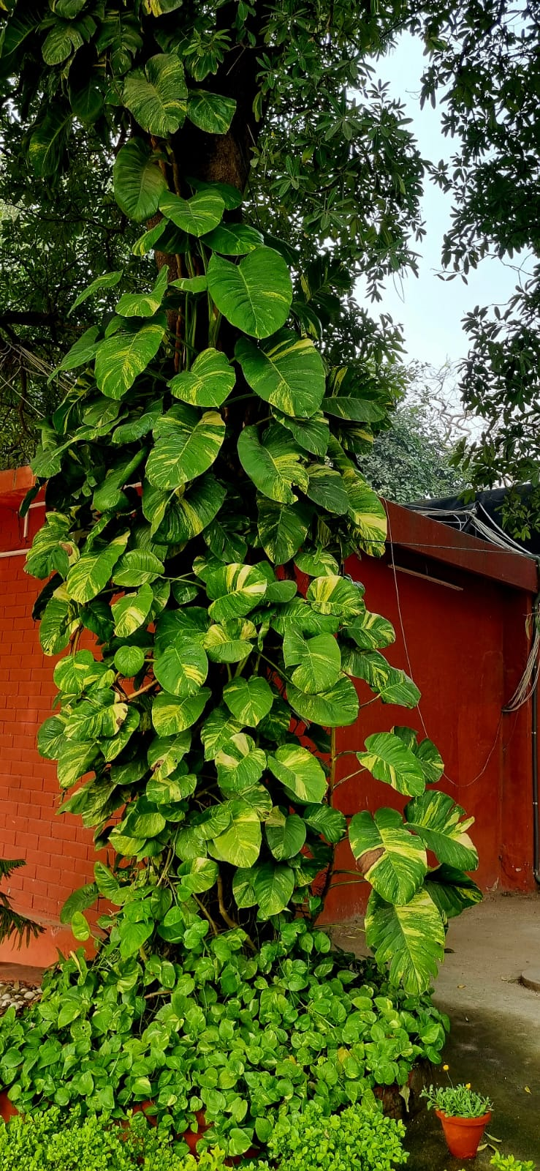
Sciendapsus- Aures
Janki Devi Memorial College
(University of Delhi)
Botanical name : Sciendapsus Aures
English name : Devil’s Ivy
Hindi name : मनी पौधा
Usage : It is a popular plant Native to Mo'orea & French Polynesia which can grow up to 20 mtrs. It is a beautiful evergreen decorative plant which removes free radicles from the ether making the space clean and fresh.
Source: Wikipedia
Picture Courtesy: JDMC Gardens
Faculty - Tara N.
Students- Shikha, Neetu, Archana

Slide 24
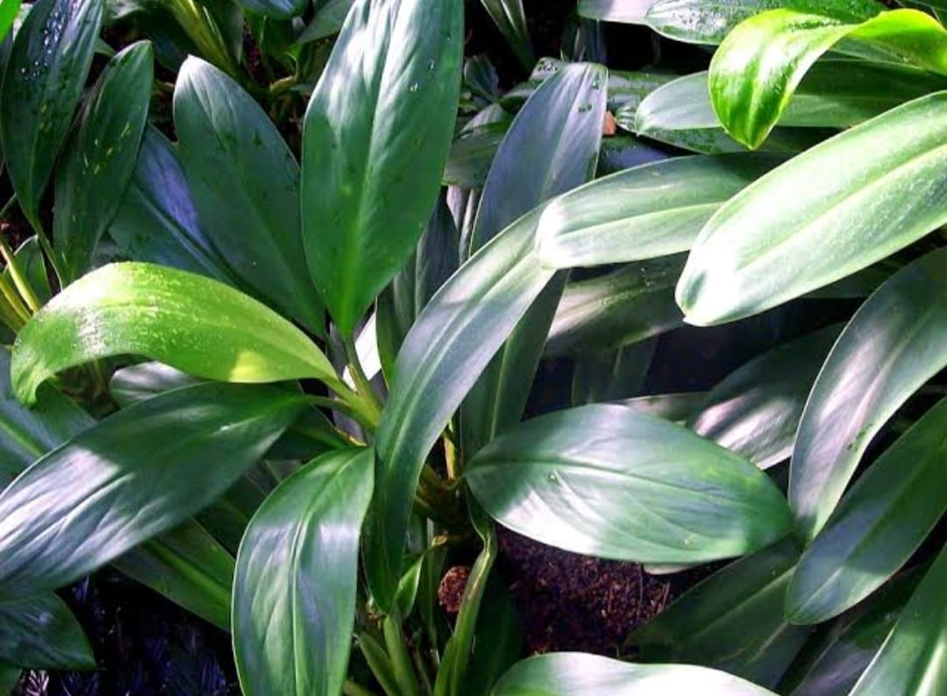
Aglaonema Nitidum
Janki Devi Memorial College
(University of Delhi)
Botanical name: Aglaonema Nitidum
English name: Burmese Evergreen
Hindi name : बर्मी सदाबहार
Usage: It helps to improve the air quality of indoor spaces with an ability to filter free radicals thereby cutting air pollution.
Source: Wikipedia
Picture Courtesy: Google
Faculty - Tara N.
Students- Shikha, Neetu, Archana

Slide 25
Bismarika Nobilis
Janki Devi Memorial College
(University of Delhi)
Botanical name :Bismarika Nobilis
English name: Bismarck Palm
Hindi Name: बिस्मार्क पाम
Usage : : The Bismarika nobilis is not used for many human or animal needs. The palm tree is mostly used for landscaping purposes. The tree works as a good focal point in a yard or landscape.
Source: Wikipedia
Picture Courtesy: JDMC Gardens
Faculty - Tara N.
Students- Shikha, Neetu, Archana

Slide 26
Tradescantia Spathacea
Janki Devi Memorial College
(University of Delhi)
Botanical name : Tradescantia Spathacea
English name : Moses- in the Cradle
Hindi name : गोद में मोसेस
Usage : Mexican by birth, can grow up to 20cms. Used for coughs, high blood pressure, skin wounds and burns.
Source: Wikipedia
Picture Courtesy: JDMC Gardens
Faculty - Tara N.
Students- Shikha, Neetu, Archana

Slide 27
Dudleya Densiflora
Janki Devi Memorial College
(University of Delhi)
Botanical name :Dudleya Densiflora / Moran Crassulaceae
English name : Sedorous Elendilive Forever
Hindi name : सेडरस रसीला
Usage : It is unique and very rarely found in small areas at the southern foot of the San Gabriel mountains which are close to the mouth of San Gabriel canyon .
Source: Wikipedia
Picture Courtesy: Google
Faculty - Tara N.
Students- Shikha, Neetu, Archana

Slide 28
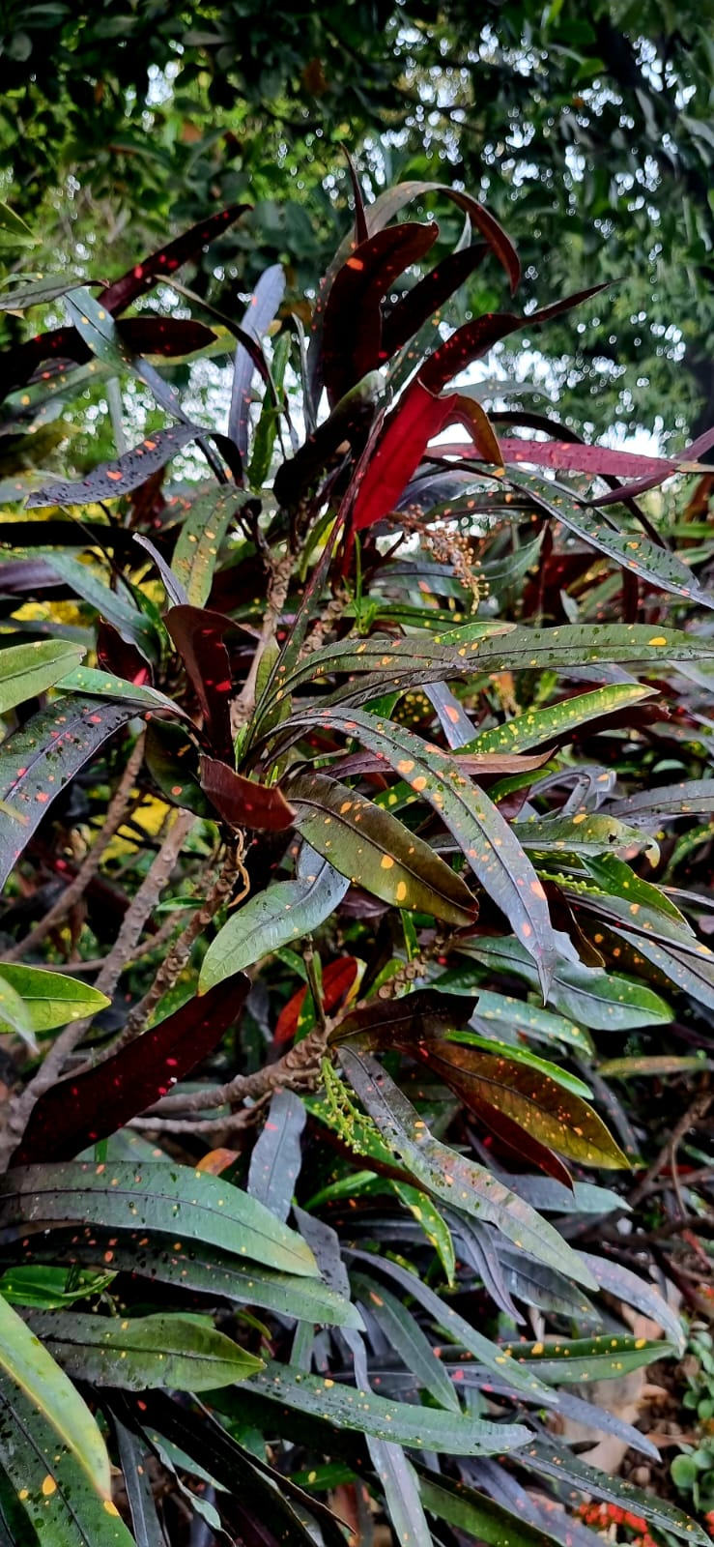
Dracaena
Janki Devi Memorial College
(University of Delhi)
Botanical name : Dracaena Fragrans
English name : Nolinoidea
Hindi name : कॉर्न पाम
Usage : The word Dracaena comes from the Ancient Greek word, Drakaina which means female dragon.
Source: Wikipedia
Picture courtesy: JDMC Gardens
Faculty - Tara N.
Students- Shikha, Neetu, Archana

Slide 29
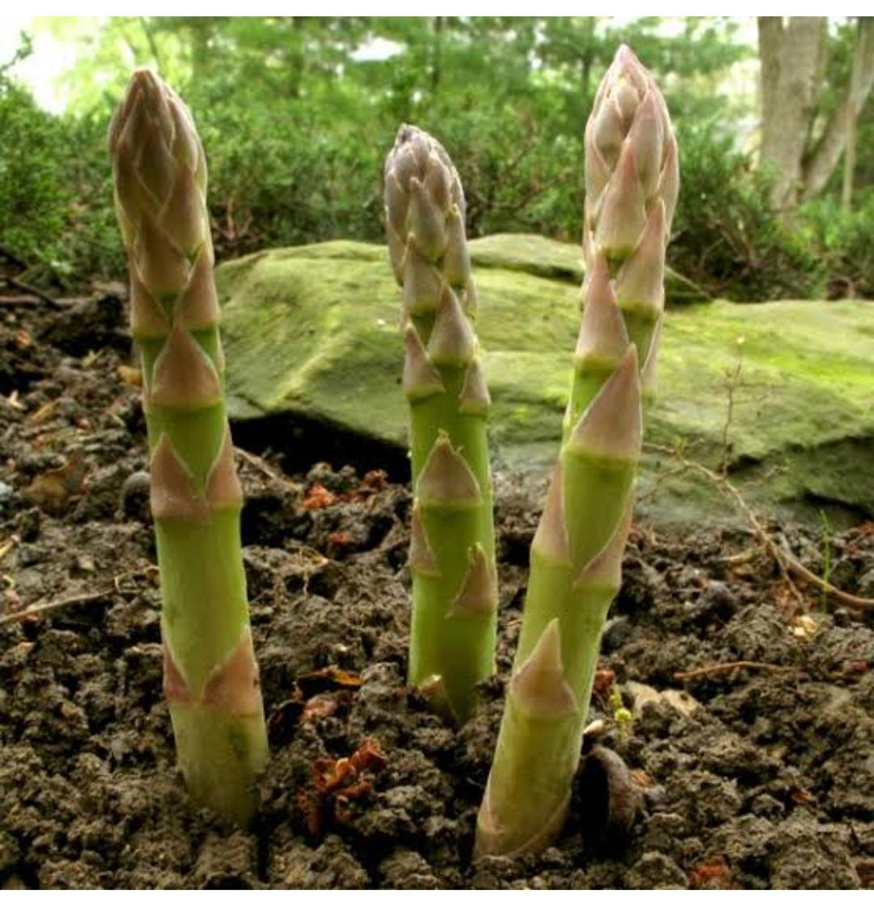
Asparagus Deniflocus
Janki Devi Memorial College
(University of Delhi)
Botanical name : Asparagus Deniflocus
English name : Sprenger
Asparagus / Asparagus Fern
Hindi name : अस्परागुस रसील
Usage: It is a variable evergreen perennial plant, closely related to the vegetable asparagus. It is native to southern Africa, from Mozambique to South Africa, but is widely cultivated.
Source: Wikipedia
Picture Courtesy: JDMC Gardens
Faculty - Tara N.
Students- Shikha, Neetu, Archana

Slide 30
Janki Devi Memorial College
(University of Delhi)
Lilium Longiflorum
Botanical name : Lilium Longflorum
English name : Easter Lily
Hindi name : लिली फूल
Usage : The bulb is antiasthmatic, antitussive, expectorant, sedative and tonic. It is used in the treatment of coughs, insomnia and fidgetiness in the later stage of fever.
Source- Wikipedia
Picture courtesy- JDMC Gardens
Faculty -Tara N.
Students- Shikha, Neetu, Archana

Slide 31
Colocasia Esulenta
Janki Devi Memorial College
(university of Delhi)
Botanical name : Colocasia Esculenta
English name : Araceal
Cocoyam (magnified)
Hindi name : अरबी का पत्ता
Usage : The juice of this plant is widely used for the treatment of body-aches and baldness.
Source: Wikipedia
Picture Courtesy: Google
Faculty - Tara N.
Students- Shikha , Neetu, Archana

Slide 32
Janki Devi Memorial College
(University of Delhi)
Senevieria Trifascisto
Botanical name : Sanevieria Trifasciato
English name : Mother- in- laws tongue
Hindi name : सासू मां की जीभ
Usage : Snake plants wonderfully filter indoor air.
It converts carbon dioxide (CO2) into oxygen at night.
Source: Wikipedia
Picture Courtesy: JDMC Gardens
Faculty - Tara N.
Students- Shikha, Neetu, Archana

Slide 33
Nephrolepis Exaltata
Janki Devi Memorial College
(University of Delhi)
Botanical name : Nephrolepis Exaltata
English name: Fishbone Fern
Hindi name:फिशबोन फर्न
Important facts: It comes under Top 10 indoor plants according to NASA .
Indigenous to tropical areas of the planet, it is a well liked houseplant that is perennial , drought- tolerant & non - toxic.
Source: Wikipedia
Picture Courtesy: Google
Faculty - Tara N.
Students- Shikha,Neetu, Archana

Slide 34
Furcraeafoetida
Janki Devi Memorial College
(University of Delhi)
Botanical name :Furcraeafoetida
English name :False Agave
Hindi name: झूठ-मूठ अगवे
Usage :The juice and sap of the Agave plant can be used to treat intestinal gas, constipation, upset stomach, weak digestion, malicious gut bacteria, stomach inflammation, and ulcer.
Source: Wikipedia
Picture Courtesy: JDMC Gardens
Faculty - Tara N.
Students- Shikha, Neetu, Archana

Slide 35
Aloejuvenna
Janki Devi Memorial College
(University of Delhi)
Botanical name :
Aloe Juvenna
Common name :Tiger Tooth Aloe
Hindi name: शेर दंत एलो
Important facts :Tiny clumping succulent which has it’s origin in Kenya.
Source: Wikipedia
Picture Courtesy: JDMC Gardens
Faculty - Tara N.
Students- Shikha, Neetu, Archana

Slide 36
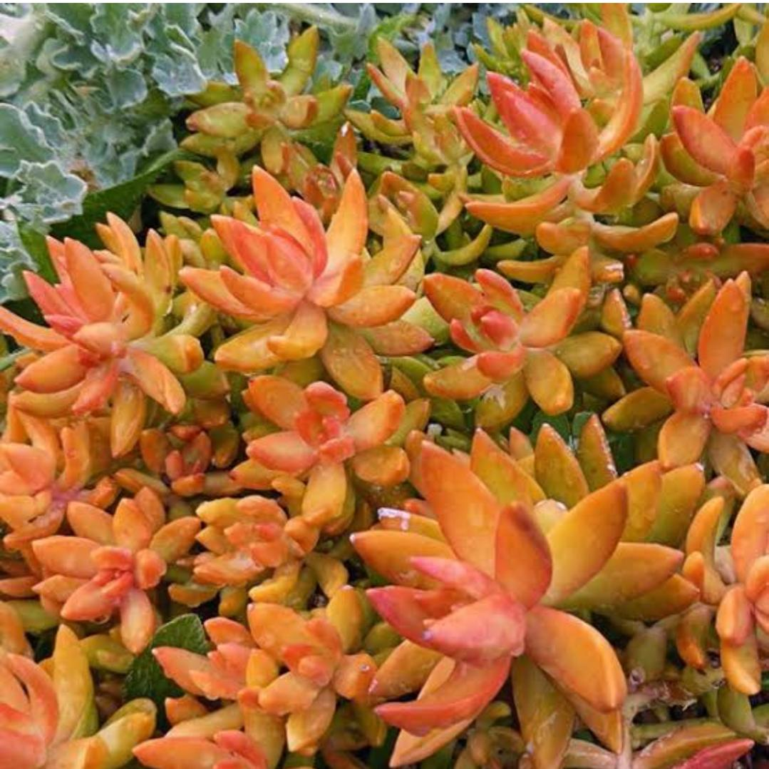
Sedum Nussbaumerianum
Janki Devi Memorial College
(University of Delhi)
Botanical name : Sedum Nussbaumerianum
Bitter CRASSULACEAE
English name : Stone Crop
Hindi name : रसीला पत्थर
Usage : Mexican by birth. It can grow upto 20cms.
The plant is designed in a flower shape.
Source : Wikipedia
Picture Courtesy: Google
Faculty - Tara N.
Students- Shikha, Neetu, Archana

Slide 37
Schefflera Arboricola
Janki Devi Memorial College
(University of Delhi)
Botanical name : Schefflera Arboricola (Hayata) Kanehira
English name :Dwarf Umbrella
Hindi name : बोना हयाता
Usage: It is a Taiwanese Native flowering plant. An evergreen shrub planted indoors for decorating purpose.
Source: Wikipedia
Picture Courtesy: Google
Faculty - Tara N.
Students- Shikha, Neetu, Archana

Slide 38
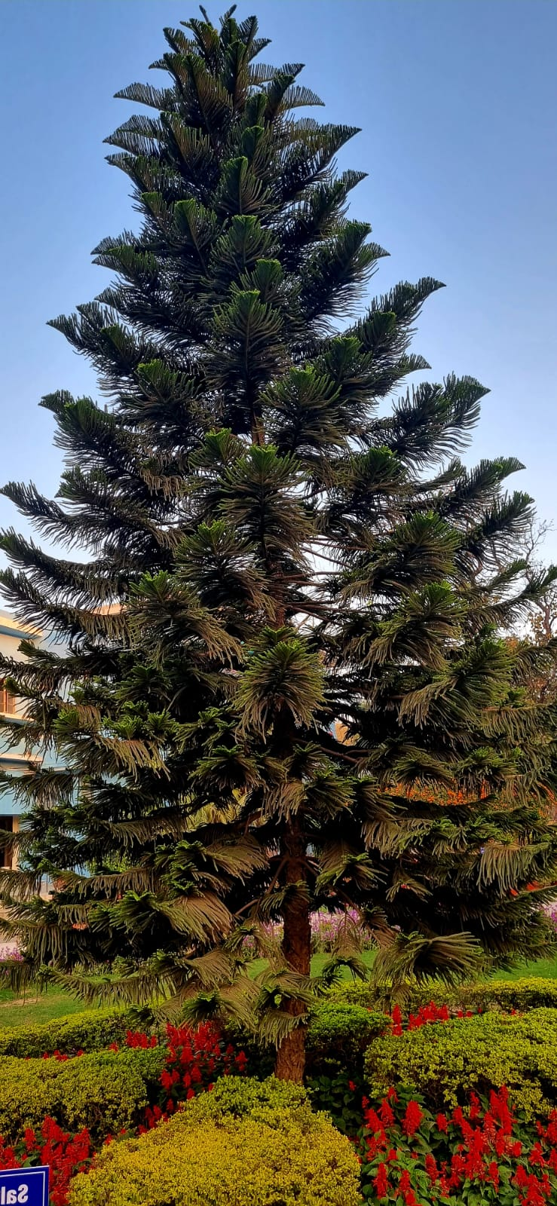
Araucaria Columnaris
Janki Devi Memorial College
(University of Delhi)
Botanical name : Auraucaria Columnaris
English name : Christmas Tree
Hindi name : क्रिसमस पेड़
Usage :Australian by birth. It is also known as cook pine tree or a Christmas tree. It is purely an aesthetic tree which is cultivated in parks & gardens.
Source: Wikipedia
Picture Courtesy: JDMC Gardens
Faculty - Tara N.
Students- Shikha, Neetu, Archana

Slide 39
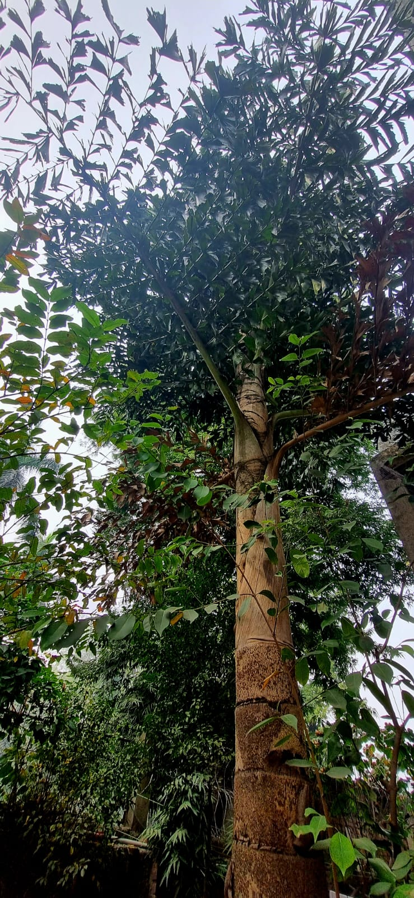
Thrinax Radiata
Janki Devi Memorial College
(University of Delhi)
Botanical name :Thrinax Radiata ARECEAE
English name :Florida Thatch Palm
Hindi name : फ्लोरिडा फूस
Usage : Its common name derives from the use of its fronds in thatched roofing. Its fronds are the most used part of the palm, being utilized in broom construction, handicrafts, and food wrapping.
Source: Wikipedia
Picture Courtesy: JDMC Gardens
Faculty - Tara N.
Students- Shikha, Neetu, Archana

Slide 40
Phoenix Roebelenii
Janki Devi Memorial College
(University of Delhi)
Botanical name :Phoenix Roebelonii
Common name :Pygmy Date Palm
Hindi name :पिग्मी खजूर
Usage : This plant is South Eastern Asian by birth. A popular decorative tree that grows slowly and requires little trimming.
Source: Wikipedia
Picture Courtesy: JDMC Gardens
Faculty - Tara N.
Students- Shikh, Neetu, Archana

Slide 41
Parodia Chrysacenthion
Janki Devi Memorial College
(University of Delhi)
Botanical name :Parodia
Chrysacenthion
English name : Yellow tower cactus
Hindi name :पीला पेरोडिया
Important facts: It is endemic to south America. It requires well- drained soil, sunlight , frequent watering in summer & no water at all in the winter to flourish
Source: Wikipedia
Picture Courtesy: Google
Faculty - Tara N.
Students- Shikha, Neetu, Archana

Slide 42
Ravenala Madagascariensis
Janki Devi Memorial College
(University of Delhi)
Botanical name : Ravenala
Madgascariensis
English name :Travelers palm
Hindi name :यात्री पाम
Usage: It is Madagascar-native ornamental plant.
The Rainwater is stored in the stem which is used by thirsty travellers in an emergency.
Source: Wikipedia
Picture Courtesy: JDMC Gardens
Faculty - Tara N.
Students- Shikha, Neetu, Archana

Slide 43
Combretum Indicum
Janki Devi Memorial College
(University of Delhi)
Botanical Name- Combretum Indicum
English Name- Rangoon Creeper
Hindi name- मधु मालती
Usage- Tis an evergreen ligenous vine with Red Flower Clusters which is native to Tropical Asia.
A Perennial, rambunctious & free branching trailer; grows vigorously if given a sturdy support.
Source: Wikipedia
Picture Courtesy: JDMC Gardens
Faculty - Tara N.
Students- Shikha, Neetu, Archana

Slide 44
Janki Devi Memorial College
(University of Delhi)
Cycas Revoluta
Botanical name :Cycas Revoluta
English name :King Sago
Hindi name :राजा साइकस
Usage : It is a decorative plant but if consumed it is toxic. Toxin concentration is even higher in seeds.
Source: Wikipedia
Picture Courtesy: Google
Faculty - Tara N.
Students- Shikha, Neetu, Archana

Slide 45
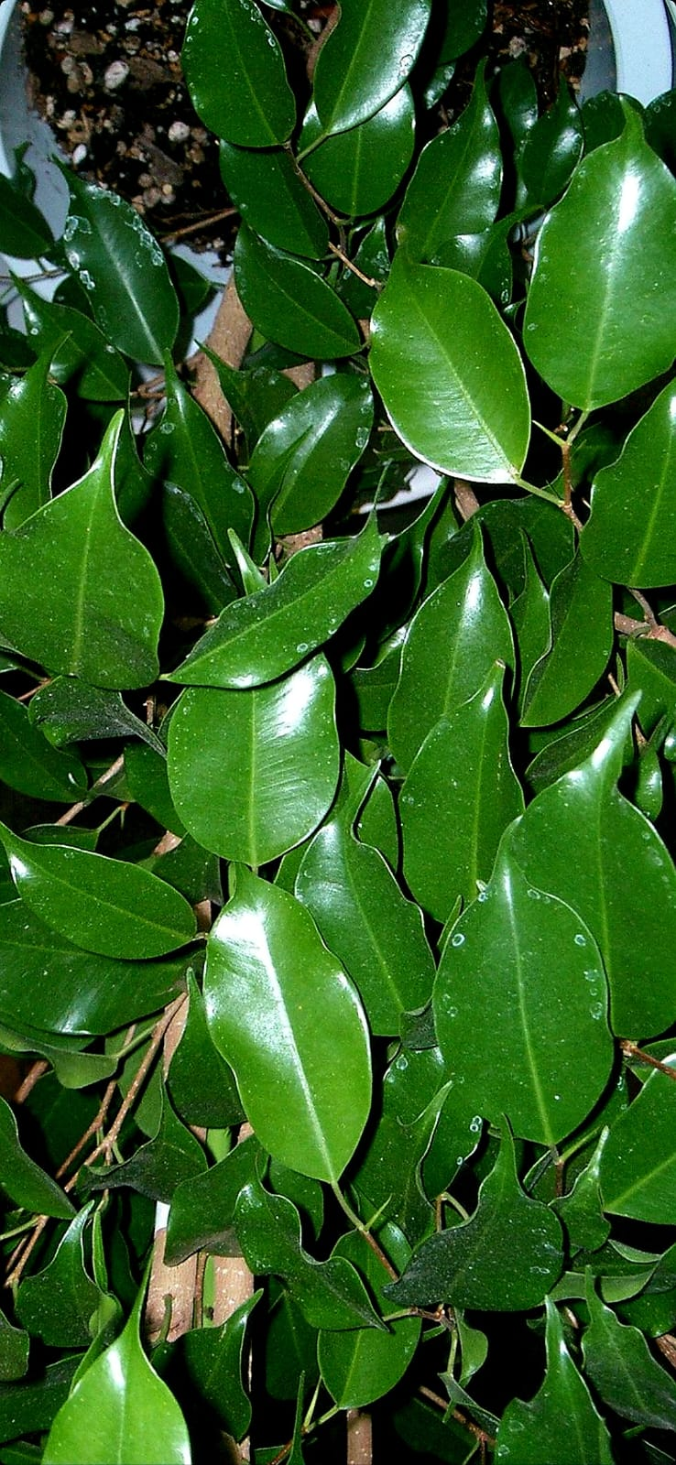
Ficus Benjamina
Janki Devi Memorial College
(University of Delhi)
Botanical name : Ficus
Benjamina
English name :Weeping Fig
Hindi name : रोतलू अंजीर
Usage :It is an Australian native and the official city of this plant is Bangkok.
The birds love its little fruits as its edible. Leaves reacts to light.
One should be cautious when using latex leaves
Source: Wikipedia
Picture Courtesy: Google
Faculty - Tara N.
Students- Shikha, Neetu, Archana

Slide 46
Bambusa Vulgaris
Janki Devi Memorial College
(University of Delhi)
Botanical name :Bambusa Vulgaris
English name: Lemon Bamboo
Hindi name : सुनहरा बांस
Usage: It is Indigenous to Indochina, also referred to as golden bamboo. Because of its high hydro carbonate content, fungus and insects make this plant vulnerable.
Source: Wikipedia
Picture Courtesy: Google
Faculty - Tara N.
Students- Shikha, Neetu, Archana

Slide 47
Petunia Atkinsiana
Janki Devi Memorial College
(University of Delhi)
Botanical name - Petunia Atkinsiana
English name- petunia
Hindi name – पिटुनिया
Usage: used for Borders, Containers, Hanging Baskets & as a Seasonal Groundcover. Petunias love full sunlight. They will get spindly with few flowers if grown in shade.
Source: Wikipedia
Picture Courtesy: JDMC Gardens
Faculty - Tara N.
Students- Shikha, Neetu, Archana

Slide 48
Janki Devi Memorial College
(University of Delhi)
Mammillaria Zeilmanniana
Botanical name-Mammillaria Zeilmanniana
English name - Rose Pincushion Cactus
Hindi name – पिन वाला कैक्टस
Usage: Eye catching Ornamental, It is an excellent plant for container pots Consumes very less water & stays small.
Source: Wikipedia
Picture Courtesy: JDMC Gardens
Faculty - Tara N.
Students- Shikha, Neetu, Archana

Slide 49
Cordyline Fruticosa
Janki Devi Memorial College
(University of Delhi)
Botanical name- Cordyline Fruticosa
English name - Palm Lily
Hindi name - गुड लक प्लांट
Usage: used for the treatment of various disorders, such as Fever, Headache, Diarrhea, Coughs, Haemoptysis, Small pox, Skin eruptions, & Joint pains etc.
Source: Wikipedia
Picture Courtesy: JDMC Gardens
Faculty - Tara N.
Students- Shikha, Neetu, Archana

Slide 50
Thuja Standishii
Janki Devi Memorial College
(University of Delhi)
Botanical name- Thuja Standishii
English name -Japanese Arborvitae
Hindi name – मोरपंख थूजा
Usage - People use Thuja for various conditions, including Respiratory Tract Infections, Cold Sores (Herpes Labialis), Osteoarthritis, and many other, but there is no proven scientific evidence to support these uses.
Source: Wikipedia
Picture Courtesy: JDMC Gardens
Faculty - Tara N.
Students- Shikha, Neetu, Archana

