Slide 1
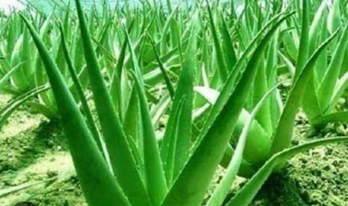
HERBS AT JDMC

Slide 2
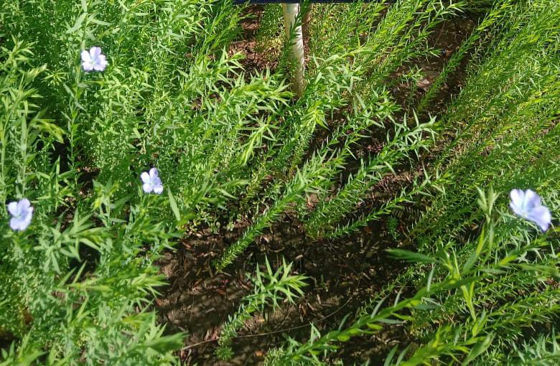
SCIENTIFIC NAME Linum Usitatissimun COMMON NAME common flax (Aalsi) INTERESTING FACT Flaxseed is commonly used to improve digestive health or relieve constipation. Flaxseed may also help lower total blood cholesterol and low-density lipoprotein (LDL, or "bad") cholesterol levels, which may help reduce the risk of heart disease.

Slide 3
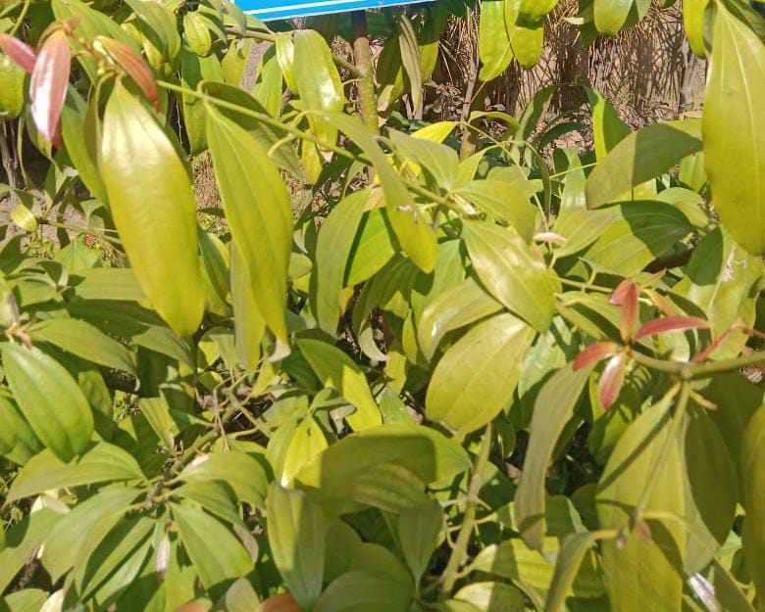
SCIENTIFIC NAME
Cinnamomum Tamala
COMMON NAME
Cinnamomum albiflorum nees
(Tejpata)
INTERESTING FACTS:
Tejpatta or Indian Bayleaf help manage high cholesterol due to its antioxidant and anti-inflammatory properties. It lowers the level of total blood cholesterol, bad cholesterol (LDL) and triglycerides. The heart-healthy fats present in Tejpatta also improves the level of good cholesterol.

Slide 4
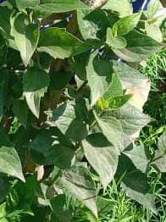
SCIENTIFIC NAME
chromolaena odoratum
COMMON NAME
Siam weed, Devil weed
INTERESTING FACTS:
Chromolaena odorata (Family: Asteraceae) synonyms as Eupatorium odoratum is a traditional medicinal plant that is widely used for its wound healing property. In particular, the several parts of this herb have been used to treat wounds, burns, and skin infections. Furthermore, it has also been shown to possess anticancer, antidiabetic, anti-hepatotoxic,anti-inflammatory, antimicrobial, and antioxidant properties.

Slide 5
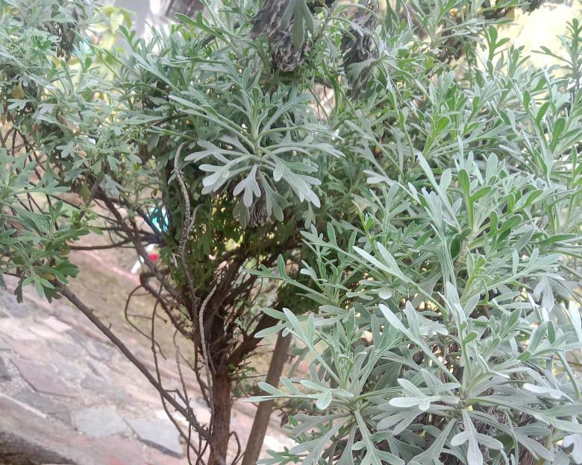
SCIENTIFIC NAME crossostephium chinense COMMON NAME Chinese wormwood (lavender) INTERESTING FACTS: Crossostephium chinensis (L.) (CC) Makinois a common traditional Chinese medicinal plant used to dehumidify and cure rheumatism and arthralgia. The water and methanol extracts of C. chinensis (CCW and CCM) were evaluated for their antioxidant and antiproliferative activities.

Slide 6
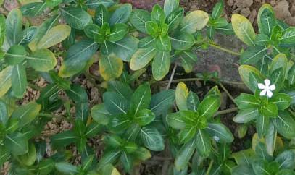
SCIENTIFIC NAME
Catharanthus roses
COMMON NAME
Brisht eyes, graveyard
(sadabahar)
INTERESTING FACTS:
In traditional medicine, the periwinkle has been used for relieving muscle pain, depression of the central nervous system, also used for applying to wasp stings and to heal wounds. Its application ranges widely from the prevention of diabetes to treatment of stomach ache.

Slide 7
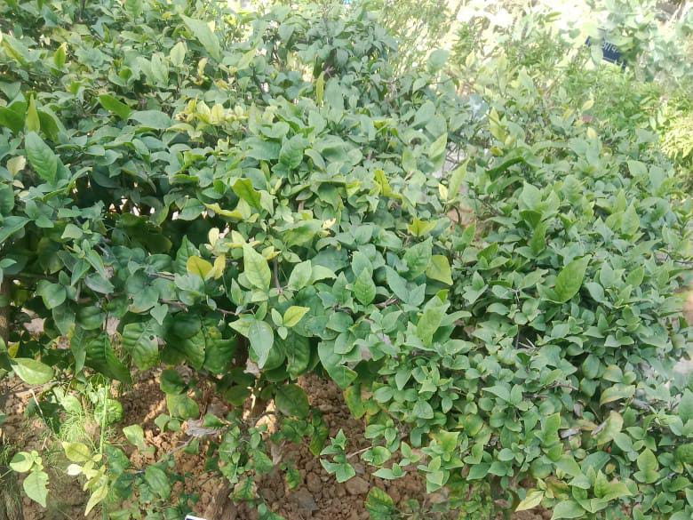
SCIENTIFIC NAME
Sauropus androgynus
COMMON NAME
Sweet leaf(katuk)
INTERESTING FACTS:
A medication for coughs, to soothe lungs, as a tonic to reduce fever, a natural slimming agent, and consumption as a vegetable.
China. To increase milk production, as an antipyretic, consumed as a vegetable and used as a colorant.
The roots are used to reduce fever and to reduce food poisoning and as an antiseptic.

Slide 8
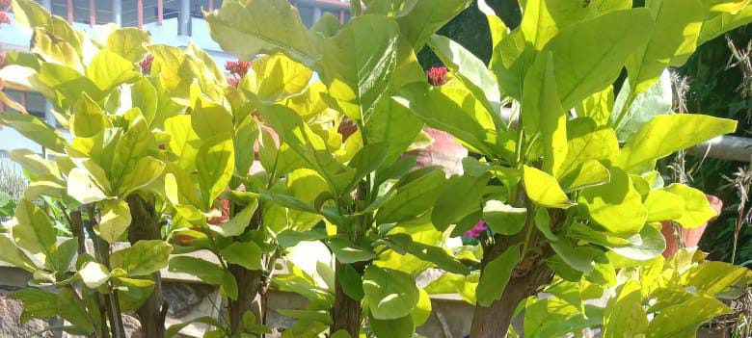
SCIENTIFIC NAME
Syzygium aqueum
COMMON NAME
Watery rose apple
(jamrul)
INTERESTING FACTS:
Fruits, leaves and bark of Watery Rose Apple fruit has many medicinal uses like fever, treatment, detoxify the liver, headaches, digestive issues, diabetes, lower cholesterol, skin-conditions and prevention against certain types of cancers . A decoction of the astringent bark of Watery Rose Apple is a local application on thrush. In Malaysia the powdered dried leaves are used to treat a cracked tongue and a preparation from the root is used to relieve itching and to reduce swelling . The leaves have been shown to possess antibiotic activity and relieving childbirth pains.Recently, it was shown to have antihyperglycemic properties .

Slide 9
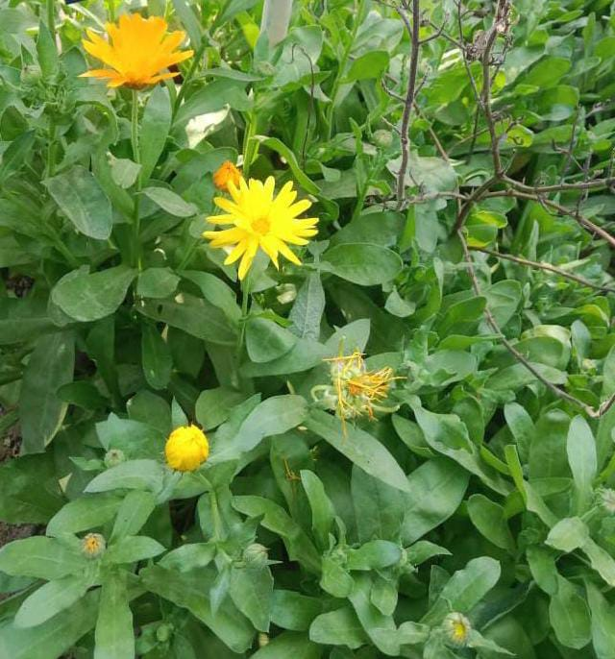
SCIENTIFIC NAME
Calendula arvensis
COMMON NAME
Field marigold
INTERESTING FACTS:
Calendula has been shown to help wounds heal faster, possibly by increasing blood flow and oxygen to the affected area, which helps the body grow new tissue. It is also used to improve skin hydration and firmness. The dried petals of the calendula plant are used in tinctures, ointments, and washes to treat burns, bruises, and cuts, as well as the minor infections they cause. Calendula also has been shown to help prevent dermatitis or skin inflammation in people with breast cancer during radiation therapy.

Slide 10
Scientific name:
Eclipta prostrata
Family:
Asteraceae
Kingdom:
Plantae
This plant is widely used in different regions of india for the treatment of skin problems, hepatic problems such as jaundice, gastrointestinal problems, respiratory problems such as asthma, and other symptoms such as fever, hair loss and whitening of hair, cuts, and wounds, spleen enlargement.

Slide 11
BAHEDA
Scientific name:
Terminalia bellirica
Family:
Combretaceae
Kingdom:
Plantae
Baheda fruit is an effective remedy to improve digestion. It helps to maintain healthy and clean bowel by removing waste products due to its bhedna or rechana (laxative) nature. Baheda also helps to remove worms from the intestine because it has krimighna (anti-worm) property

Slide 12
)
CHIKU (SAPODILLA PLANT
Scientific name:
Manilkara zapota
Higher classification:
Manilkara
Rank:
Species
Chikoo contains a high dose of antioxidants and has been found to be effective in lowering the risk of different types of cancers. It contains a healthy level of vitamins A and B which help in the maintenance of the several mucus linings in the body. This can in turn help to reduce the risk of lung and oral cancers.

Slide 13
HAR SHRINGAR
Scientific name:
Nyctanthes arbor-tristis
Family:
Oleaceae
Kingdom:
Plantae
Jasmine oil is used in aromatherapy to relieve stress and anxiety. It helps by increasing the serotonin levels in the brain and regulating mood. Boil some leaves in water and have them once a day to reduce any kind of pain and swelling in the body.

Slide 14
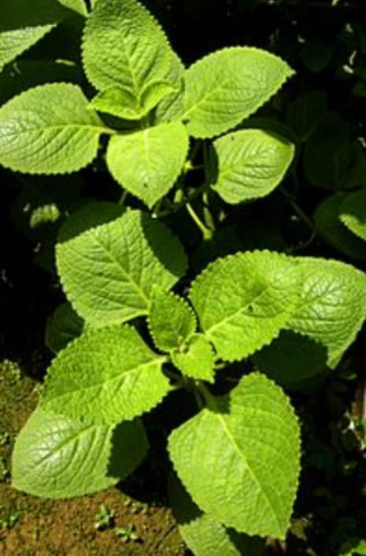
PLECTRANTHUS AMBOINICUS
Plectranthus amboinicusIt is widely used in folk medicine to treat conditions like cold, asthma, constipation, headache, cough, fever and skin diseases. The leaves of the plant are often eaten raw or used as flavoring agents, or incorporated as ingredients in the preparation of traditional food.

Slide 15
ACHYRANTHES ASPERA
Scientific name:
Achyranthes aspera
Family:
Amaranthaceae
Kingdom:
Plantae
Achyranthes Aspera is used in the treatment of boils, asthma, in facilitating delivery, bleeding, bronchitis, debility, dropsy, cold, colic, cough, dog bite, snake bite, scorpion bite, dysentery, earache, headache, leukoderma, renal complications, pneumonia, and skin diseases.

Slide 16
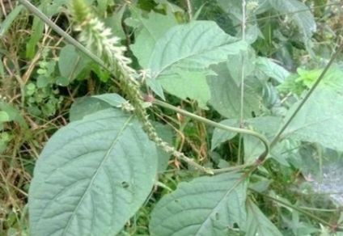
LATJEERA
Scientific name:
achyranthes aspera
Family :
amaranthacease
Kingdom:
plantae
LatzeraIt is extremely beneficial to take rough chaff tree' leaves juice in cold and cough. According to aborigines if you take two to three time per day then it heals chronic cough. According to aborigines, use rough chaff tree root mixed with milk

Slide 17
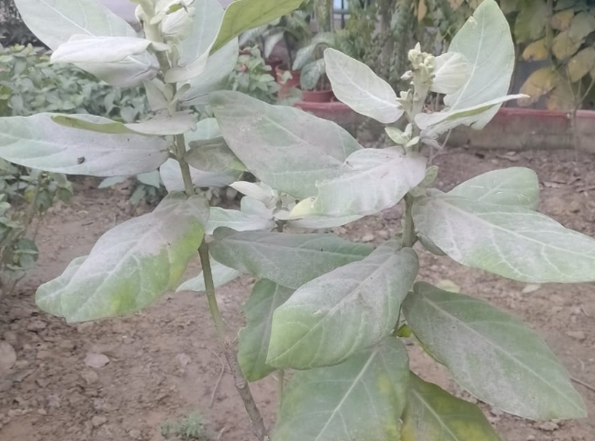
Aak
Scientific name:
Calotropis gigantea
Family:
Apocynaceae
Kingdom:
Plantae
Aak (calotropis procera) is a drug of herbal origin, which has been in use for medicinal purpose since time immemorial. Calotropis procera is a well known plant and has been traditionally used for diarrhoea, stomatic, sinus fistula, and skin disease, and the leaf part is used to treat jaundice.

Slide 18
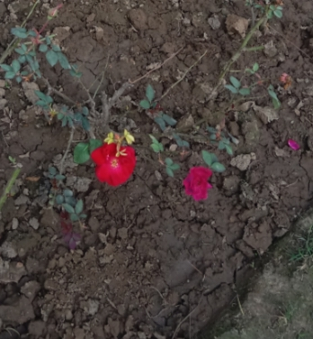
ROSE PLANT
Scientific name:
RosaHigher
classification:
Rosoideae
Rank:
Genus
It help us to Reducing anxiety. A cup of rose tea can help to soothe anxiety and reduce stress, improving digestion, Soothing cramps, High in antioxidants, Contains antimicrobial propertie, Reducing inflammation ,High in antioxidants ,High in vitamin C.

Slide 19
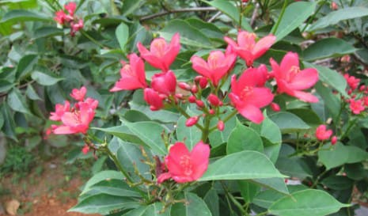
JATROPHA INTEGERRMIA
Scientific Name:
Jatropha integerrima
(commonly known as peregrina or spicy jatropha)
species
flowering plant
Family:
Euphorbiaceae
Species:
J. Integerrima
The latex of Jatropha contains an alkaloid known as “Jatrophine” which is believed to have anti-cancer properties. It is also used for skin diseases, rheumatism and for sores on domestic livestock . The white latex serves as a disinfectant in mouth infections in children.

Slide 20
POPPY PLANT
Scientific name:
Papaver somniferum
Family:
Papaveraceae
Kingdom:
Plantae
The flower part of the poppy plant is used to obtain the drug "Smack".The poppy plant, Papaver somniferum, produces opium, a powerful narcotic whose derivatives include morphine, codeine, heroin, and oxycodone.

Slide 21
Scientific Name: Sabal minor Common Name Dwarf palmetto
Interesting fact: Native American tribes were known for using the dwarf palm for medicine and food. The Houma sliced the roots and baked them like a type of bread. They also used the dried roots in a decoction for the treatment of high blood pressure and kidney and urinary problem.

Slide 22
Scientific Name: Crossandra Common Name: firecracker plant
Interesting fact: this is one of the very few plant that can bloom for months on end with indirect sunlight, making it a popular houseplant. When planted outdoor under the right conditions, the firecracker plant blooms fiery red flowers that last from late spring to autumn

Slide 23
Scientific Name: Crown daisy Common Name: Garland chrysanthemum
Interesting fact: Daisies are actually closely related to artichokes, so they are a great source of vitaminC Additionally , daisies also have lots of medicinal properties- they are known to slow bleeding, relieve indigestion, and soothe coughs.

Slide 24
Scientific Name: Salvia Coccinea Common Name: Scarlet Saga
Interesting fact: This plant attracts slugs, snails and whitefly and when at the nursery carefully check the underside of the leaves for whitefly as they are a greenhouse pest. Essential oils of the plant are toxic to mosquito larvae.

Slide 25
Scientific Name: Jasminum sambac Common Name: Arabian jasmine
Interesting fact: It is highly fragrant flowers are prized. In fact, it’s the national plant of the Philippines and one of the three national plant of Indonesia! The floral aroma is used in china to scent jasmine teas, and jasmine flowers adorn leis in the Hawaiian island.

Slide 26
Scientific Name: Nyctanthes aebor-tristis Common Name: Night flowering jasmine
Interesting fact: It develops bell-shaped blooms with white, waxy petals. Most species originate from South and Sotheast Aisa but there are some that are native of Africa as well

Slide 27
Scientific Name: chrysobalanus icaco Common Name: Coco plum
Interesting fact: Coco plum contain Vitamin A, Vitamin C, Vitamin k, Iron, Calcium, Potassium, Protein, Dietary fiber , Copper and beta- carotene. This small fruit can really pack a BIG PUNCH and help to maintain our health in so many ways

Slide 28
Scientific Name: Rosa rubiginosa Common Name: Natikrd rose plant
Interesting fact: Roses are erect climbing, or trailing shrubs, the stems of which are usually copiously armed with pricles of various shapes and sizes, commonly called thorns.

Slide 29
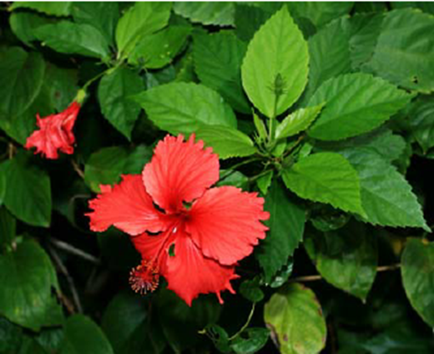
Scientific Name Hibiscus Rosa Sinensis Common Name China Rose ( गुढ़ल ) Interesting Fact Chinese hibiscus is a large shrub that is a member of the Malvaceae (mallow) family. It is native to Asia. It grows 4 to 10 feet high and 5 to 8 feet wide, so consider its space requirements when determining its planting location. This is a tropical, evergreen plant known for its bold flowers that can be up to 6 inches across with a showy central tube. The genus name Hibiscus is Latin for mallow and the species names rosa sinensis are Latin for rose and Chinese.

Slide 30
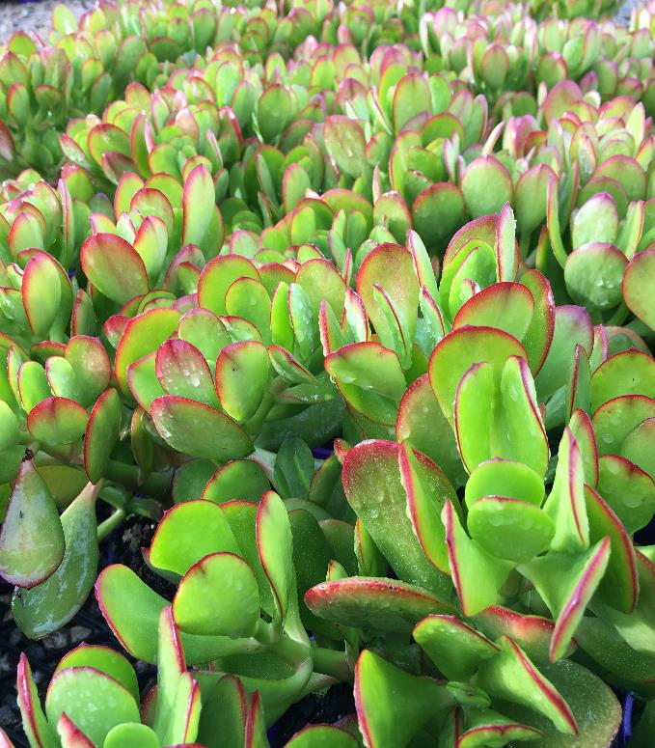
Scientific Name Crassula ovata Common Name Jade plant/Money plant (जेड पौधा) Interesting Fact This succulent plant only grows in parts of Mozambique and South Africa. In nature, this species of Crassula can be found in the Eastern Cape and KwaZulu-Natal provinces. Crassula grows among shrubs in light forests, on sandy clay gray soil, on rocky slopes, hills and fields, often in sheltered ravines, together with various species of Aloe, Euphorbia and other desert crops. Nowadays it can be found all over the world, and many varieties with amazing shapes and coloring of the leaves have also been bred.

Slide 31
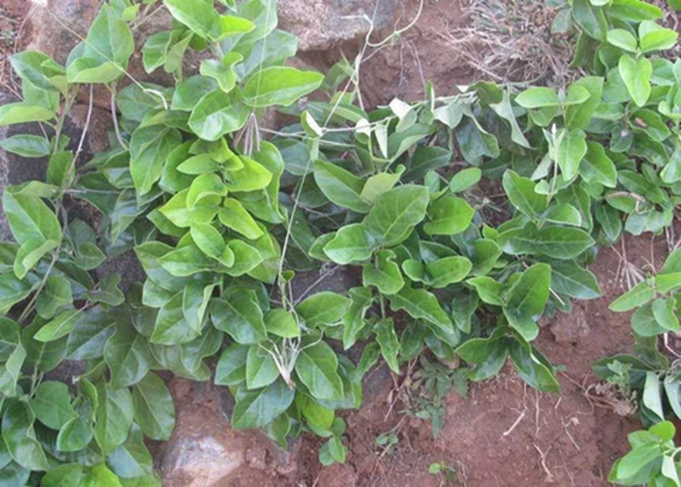
Scientific Name Tylophora Indica Common Name Antomul/Indian Ipecac (दमI बेल) Interesting Fact Tylophora indica (family Apocynaceae) is a perennial climbing plant used in the Ayurvedic system of medicine. The leaves of the plant have been extensively used in the treatment of various inflammatory and allergic disorders including bronchial asthma, bronchitis, whooping cough etc. The extracts of the leaves of T. indica have antiasthmatic and antiallergic potential .The extract of T. indica leaves showed inhibition of cellular immune responses in experimental models

Slide 32
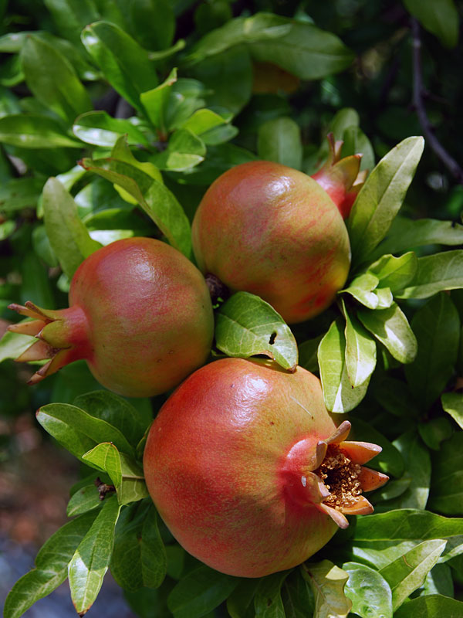
Scientific Name Punica Granatum Common Name Pomegranate (अनार) Interesting Fact Pomegranate is a small, fruit-bearing tree native to Iran and northern India and cultivated around the world. Ancient writings described pomegranate as a sacred fruit that provided fertility, abundance, and luck. Preparations from pomegranate including the juice or extract have been promoted for prevention or treatment of many conditions including heart disease, high blood pressure, high blood cholesterol levels, cancer, and diabetes

Slide 33
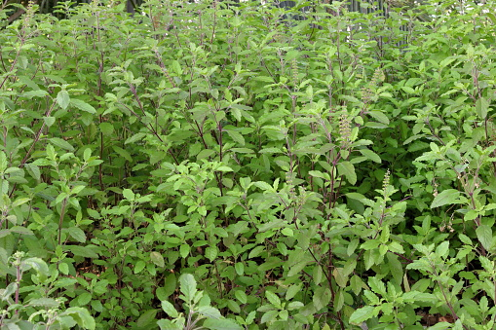
Scientific Name Ocimum Basillion Common Name Holy Basil (तुलसी) Interesting Fact Ocimum is a genus of aromatic annual and perennial herbs and shrubs in the family Lamiaceae, native to the tropical and warm temperate regions of all 6 inhabited continents, with the greatest number of species in Africa. Its best known species are the cooking herb great basil, O. basilicum, and the medicinal herb tulsi (holy basil), O. tenuiflorum. Leaves and flowers - raw or cooked. Used as a flavouring or as a spinach. The leaves are normally used fresh but can also be dried for winter use and the leaves sparingly in cooking because the heat concentrates the flavour. A refreshing tea is made from the leaves. The seed can be eaten on its own or added to bread dough as a flavoring.

Slide 34
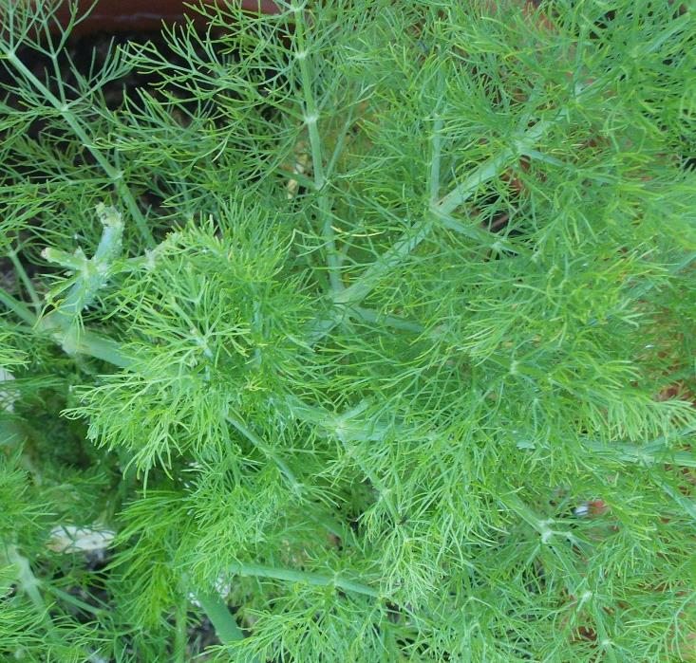
Scientific Name Foeniculum Vulgare Common Name Fennel (सौंफ) Interesting Fact Fennel is a flowering plant species in the carrot family. It is a hardy , perennial herb with yellow flowers and feathery leaves. It is indigenous to the shores of Mediterranean but has become widely naturalized in many parts of the world, especially on dry soils near the sea coast and on riverbanks. It is highly flavorful herb used in cooking along with the similar tasting anise. It is swollen , bulb like stem base that is used as vegetables.

Slide 35
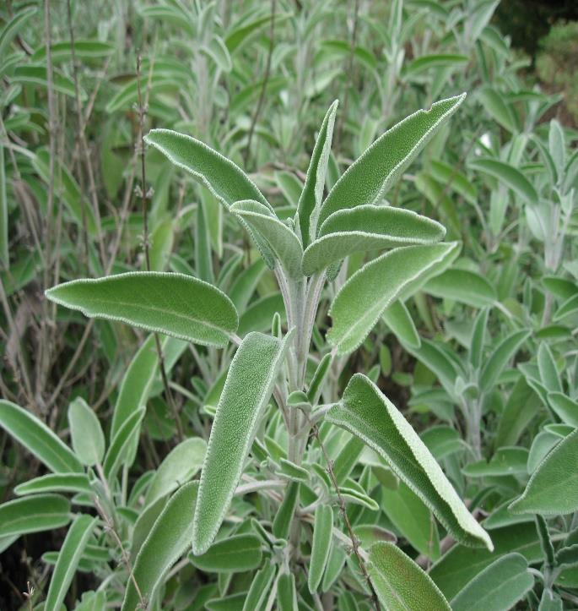
Scientific Name Salvia Officinalis Common Name Sage ( ऋषि ) Interesting Fact the common sage or just sage, is a perennial, evergreen subshrub, with woody stems, grayish leaves, and blue to purplish flowers. It is a member of the mint family Lamiaceae and native to the Mediterranean region, though it has been naturalized in many places throughout the world. It has a long history of medicinal and culinary use, and in modern times it has been used as an ornamental garden plant. The common name "sage" is also used for closely related species and cultivars.

Slide 36
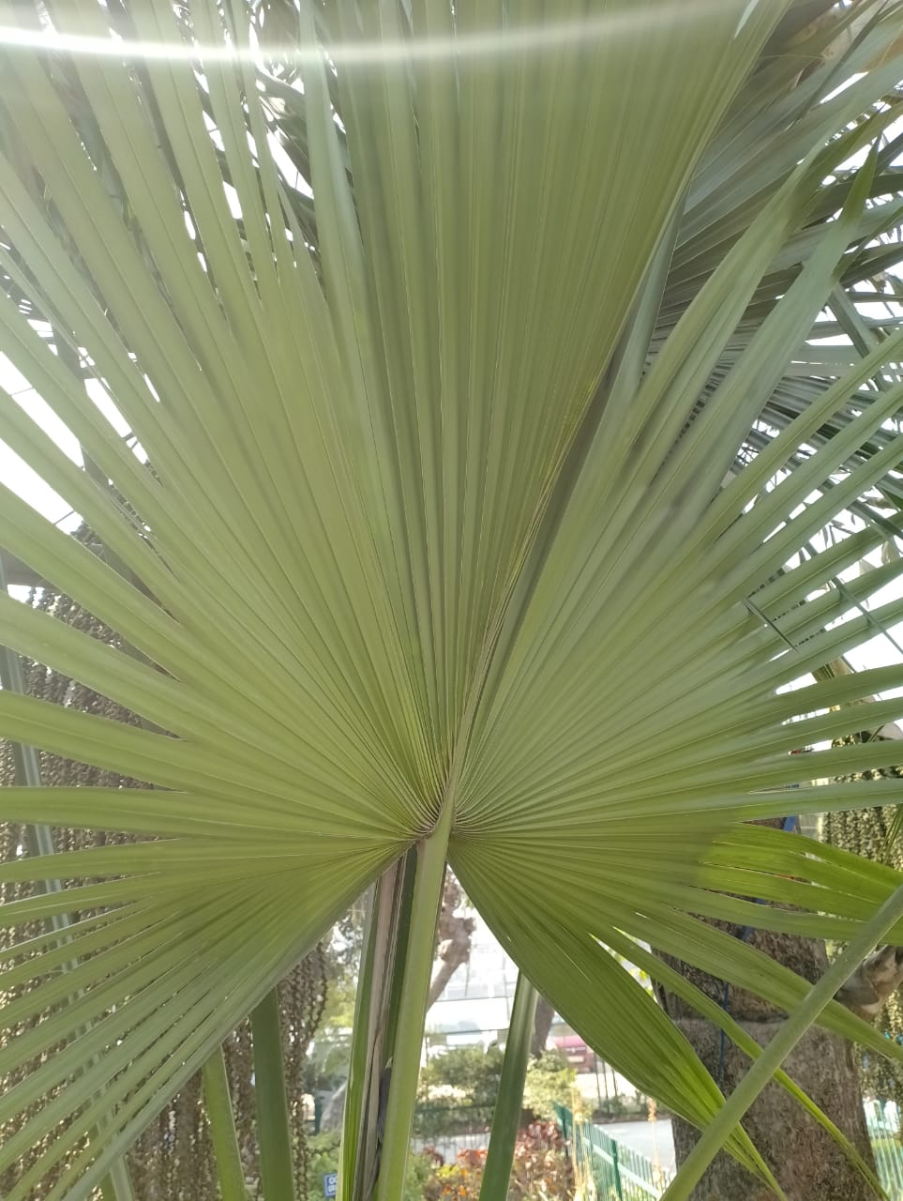
Scientific Name: Sabal minor Common Name:
Dwarf palmetto
Interesting fact: Native American tribes were known for using the dwarf palm for medicine and food. The Houma sliced the roots and baked them like a type of bread. They also used the dried roots in a decoction for the treatment of high blood pressure and kidney and urinary problem.

Slide 37
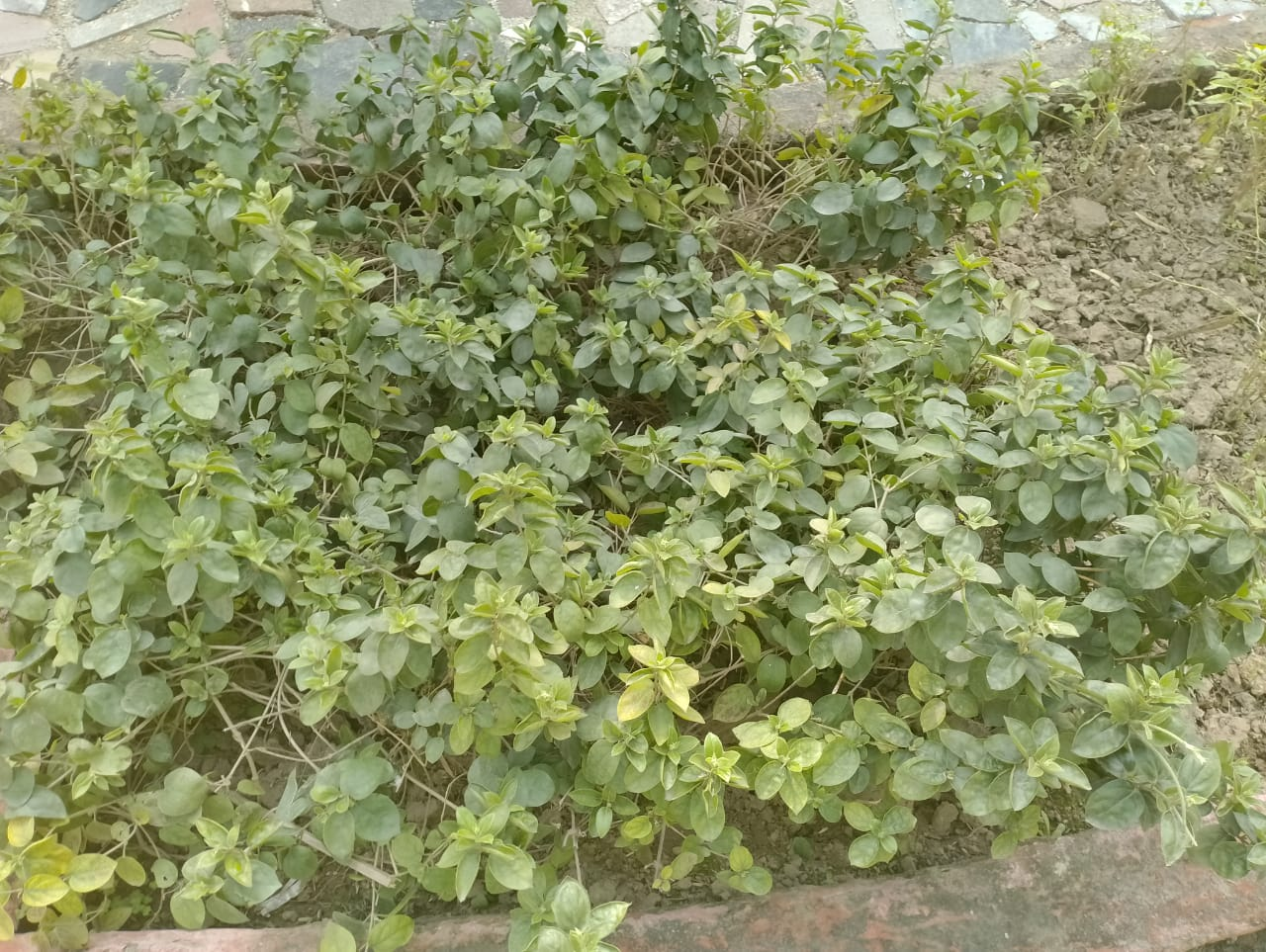
Scientific Name: Crossandra Common Name: Firecracker plant
Interesting fact: this is one of the very few plant that can bloom for months on end with indirect sunlight, making it a popular houseplant. When planted outdoor under the right conditions, the firecracker plant blooms fiery red flowers that last from late spring to autumn

Slide 38
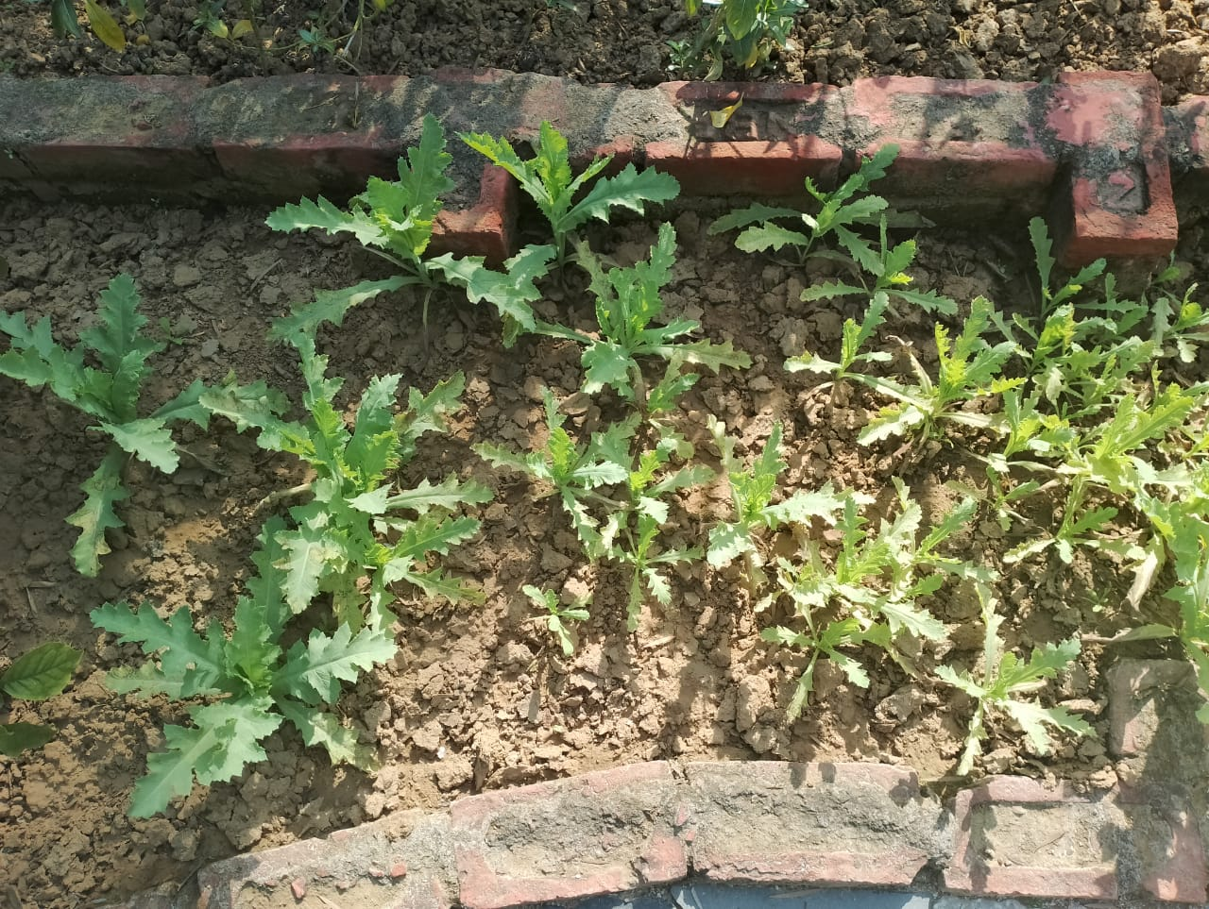
Scientific Name: Crown daisy Common Name: Garlandchrysanthemum
Interesting fact: Daisies are actually closely related to artichokes, so they are a great source of vitaminC Additionally , daisies also have lots of medicinal properties- they are known to slow bleeding, relieve indigestion, and soothe coughs.

Slide 39
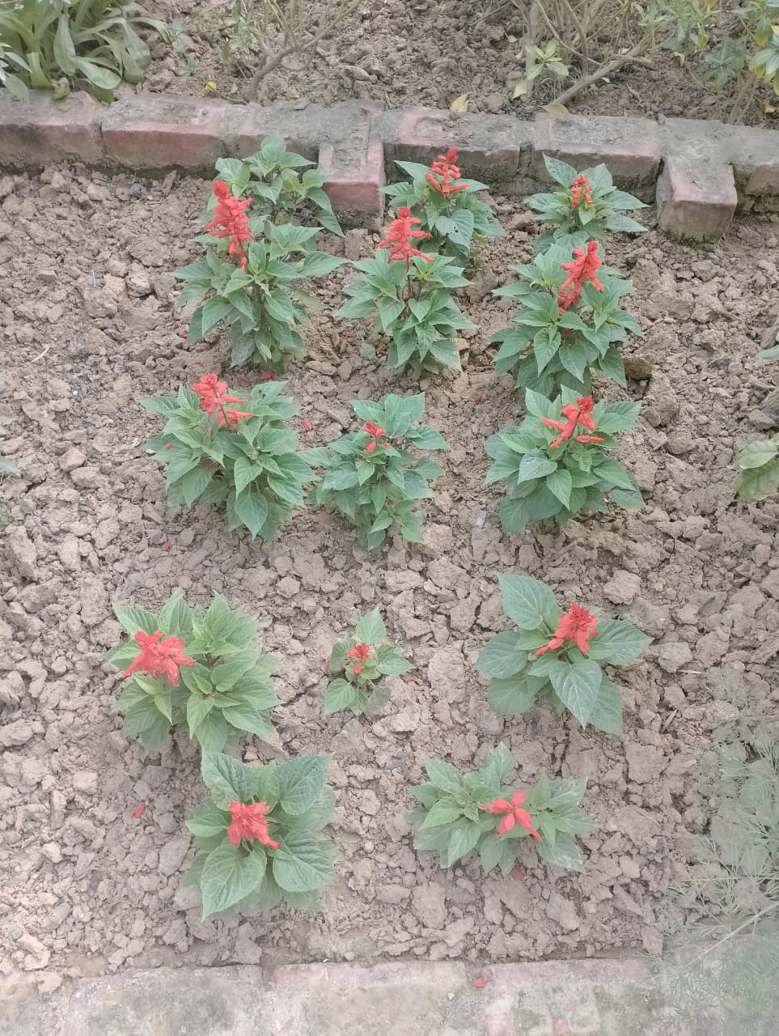
Scientific Name: Salvia Coccinea Common Name: Scarlet Saga
Interesting fact: This plant attracts slugs, snails and whitefly and when at the nursery carefully check the underside of the leaves for whitefly as they are a greenhouse pest. Essential oils of the plant are toxic to mosquito larvae.

Slide 40
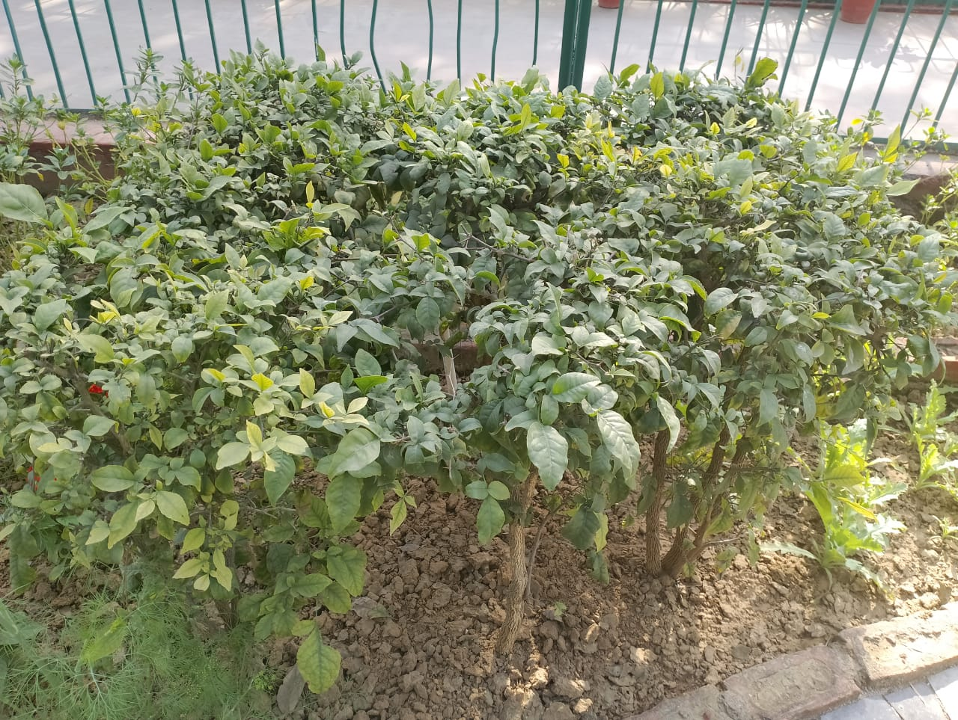
Scientific Name: Jasminum sambac Common Name: Arabian jasmine
Interesting fact: It is highly fragrant flowers are prized. In fact, it’s the national plant of the Phillipines and one of the three national plant of Indonesia! The floral aroma is used in china to scent jasmine teas, and jasmine flowers adorn leis in the Hawaiian island.

Slide 41
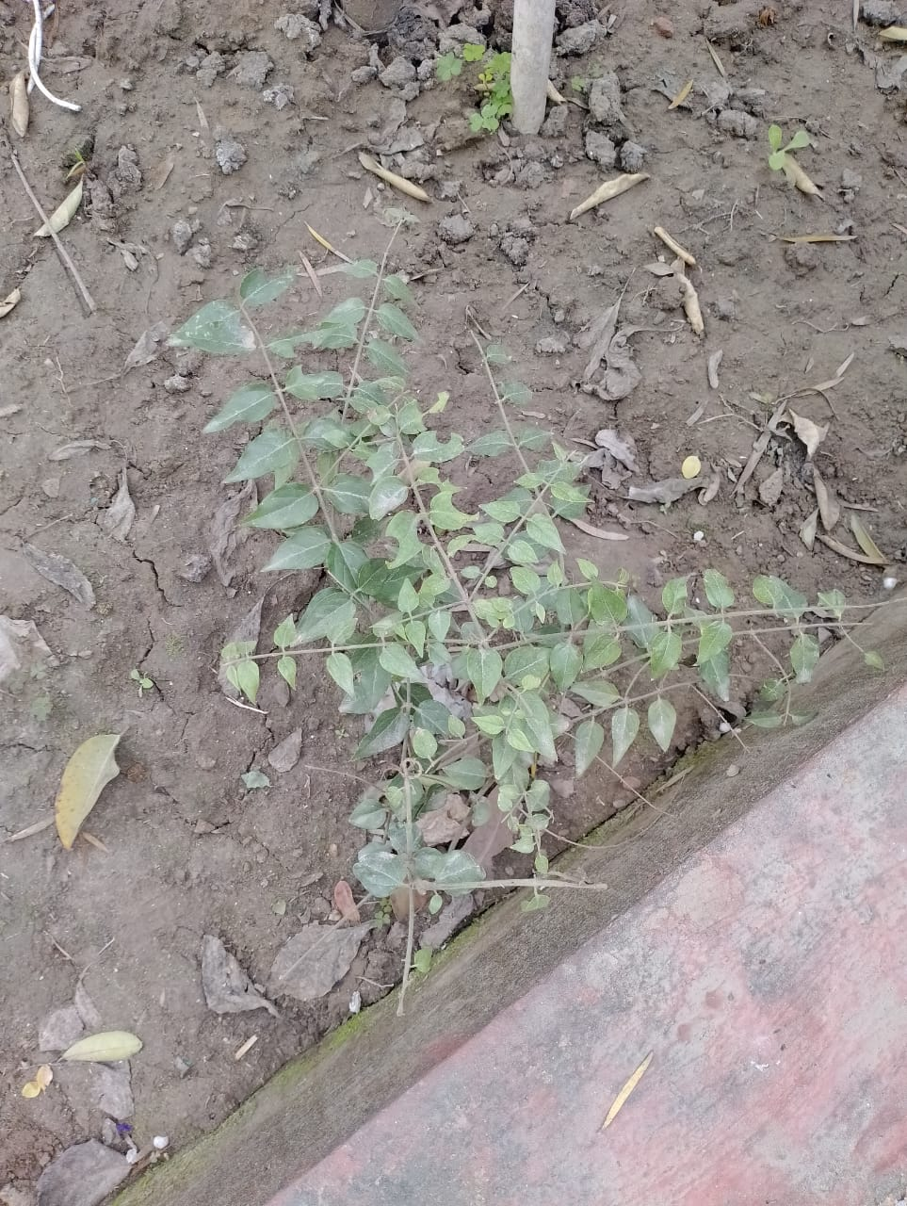
Scientific Name: Nyctanthes aebor-tristis Common Name: Night flowering jasmine
Interesting fact: It develops bell-shaped blooms with white, waxy petals. Most species orginate from South and Sotheast Aisa but there are some that are native of Africa as well

Slide 42
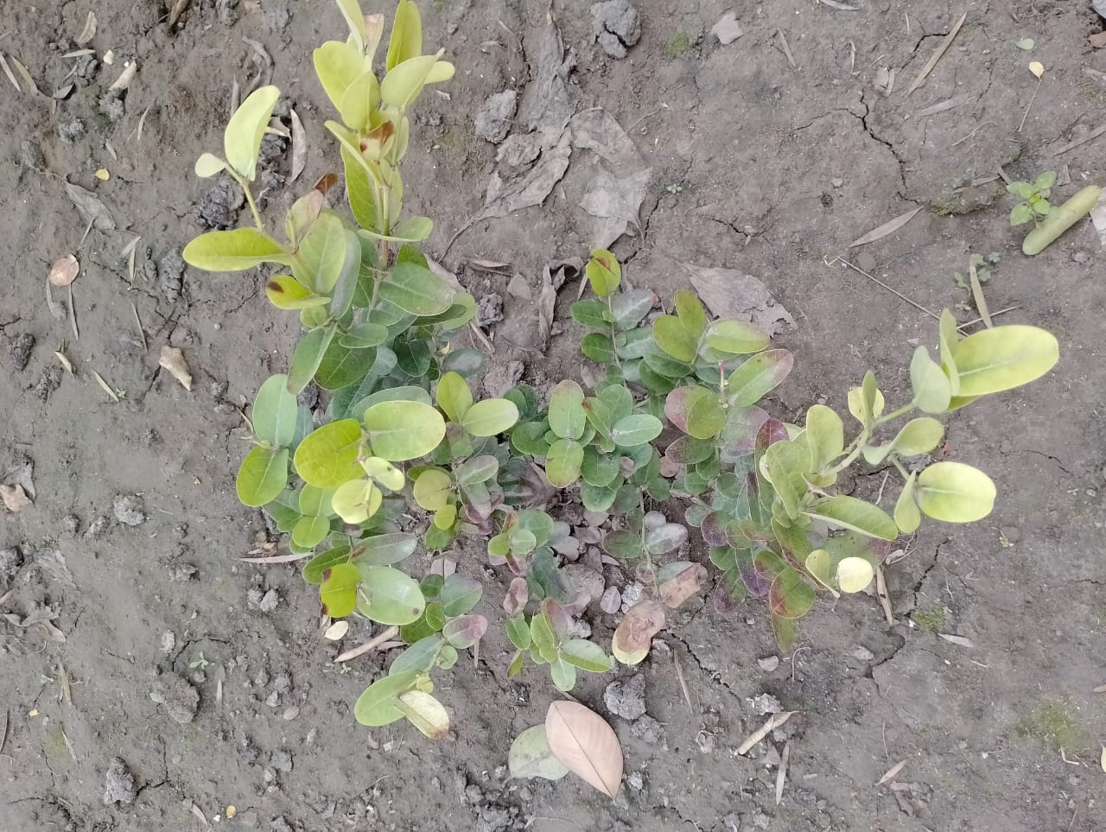
Scientific Name: chrysobalanus icaco Common Name: Coco plum
Interesting fact: Coco plum contain Vitamin A, Vitamin C, Vitamin k, Iron, Calcium, Potassium, Protein, Dietary fiber , Copper and beta- carotene. This small fruit can really pack a BIG PUNCH and help to maintain our health in so many ways

Slide 43
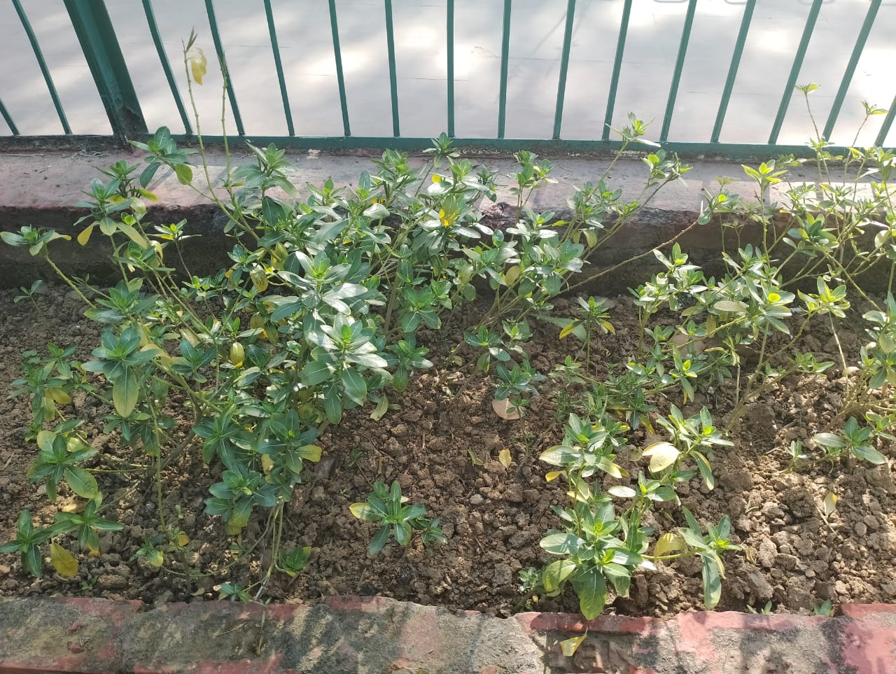
Scientific Name: Rosa rubiginosa Common Name: Natikrd rose plant
Interesting fact: Roses are erect climbing, or trailing shrubs, the stems of which are usually copiously armed with pricles of various shapes and sizes, commonly called thorns.

Slide 44
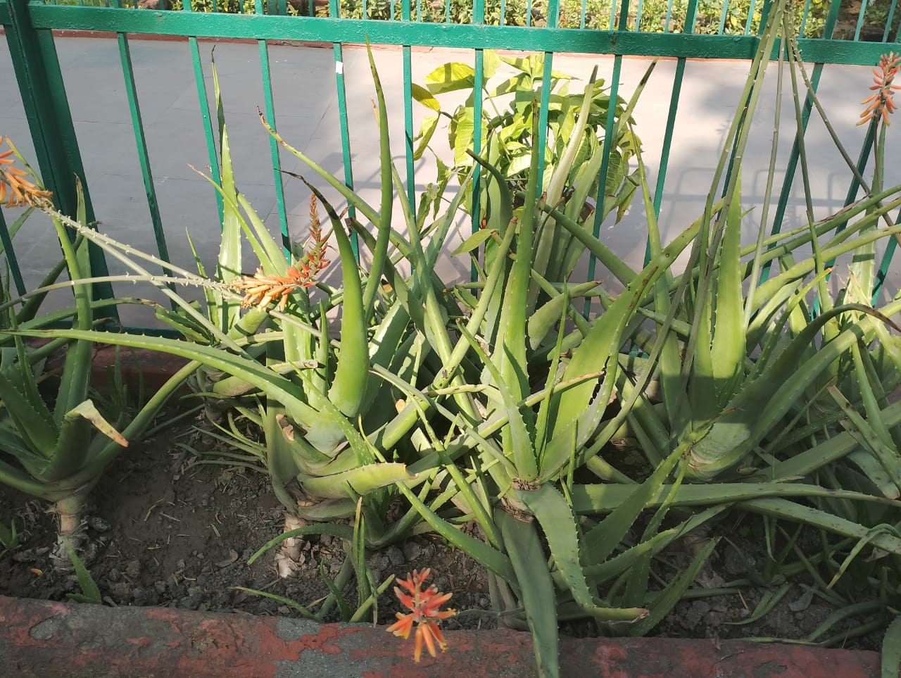
BOTANICAL NAME-
Aloe barbadensis miller
COMMON NAME-
Aloe vera
INTERESTING FACT-
Aloe vera is the only edible form of aloe. The aloe vera plant is native to the Arabian peninsula, but it grows throughout the world. This shrubby, pointy plant has been cultivated for its soothing gel for thousands of years.

Slide 45
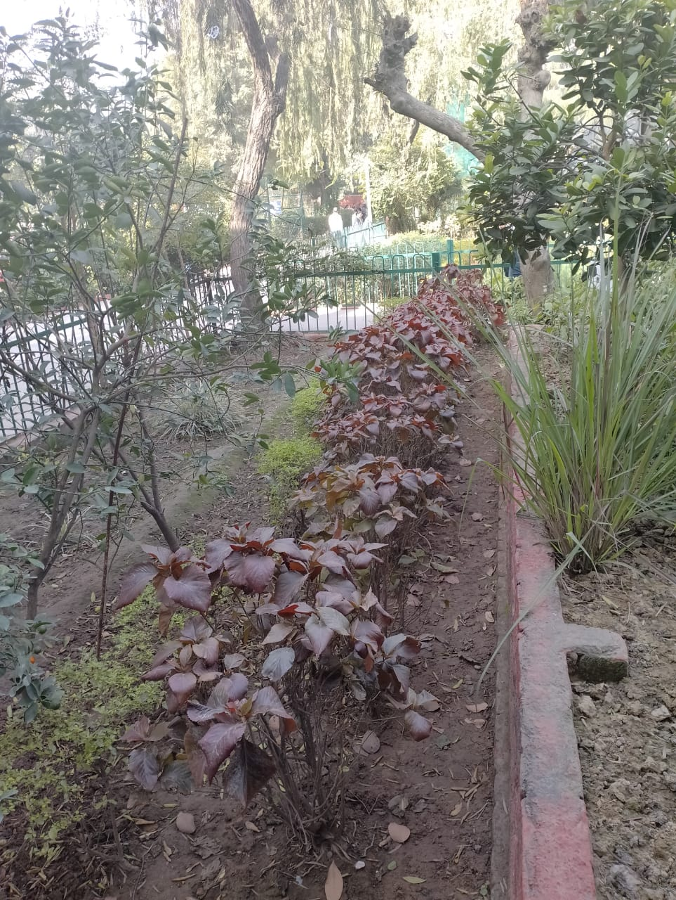
BOTANICAL NAME-
Euphorbia cotinifolia
COMMON NAME-
smoketree spurge, tropical smoke bush, Caribbean copper plant, and Mexican shrubby spurge
INTERESTING FACT-
Euphorbia cotinifolia is a deciduous tropical shrub possessing many medicinal applications. The leaves of the plant had been employed as poison for catching fish by Southern American Indians. The latex is strongly purgative and the leaves have molluscicidal and antiviral properties

Slide 46
BOTANICAL NAME-
Litsea glaucescens
COMMON NAME-
Mexican bay leaf
INTERESTING FACT-
Litsea glaucescens (Lauraceae) has been used in Mexican Traditional Medicine to relieve illness related to central nervous system, such as epilepsy, fright and sadness.

Slide 47
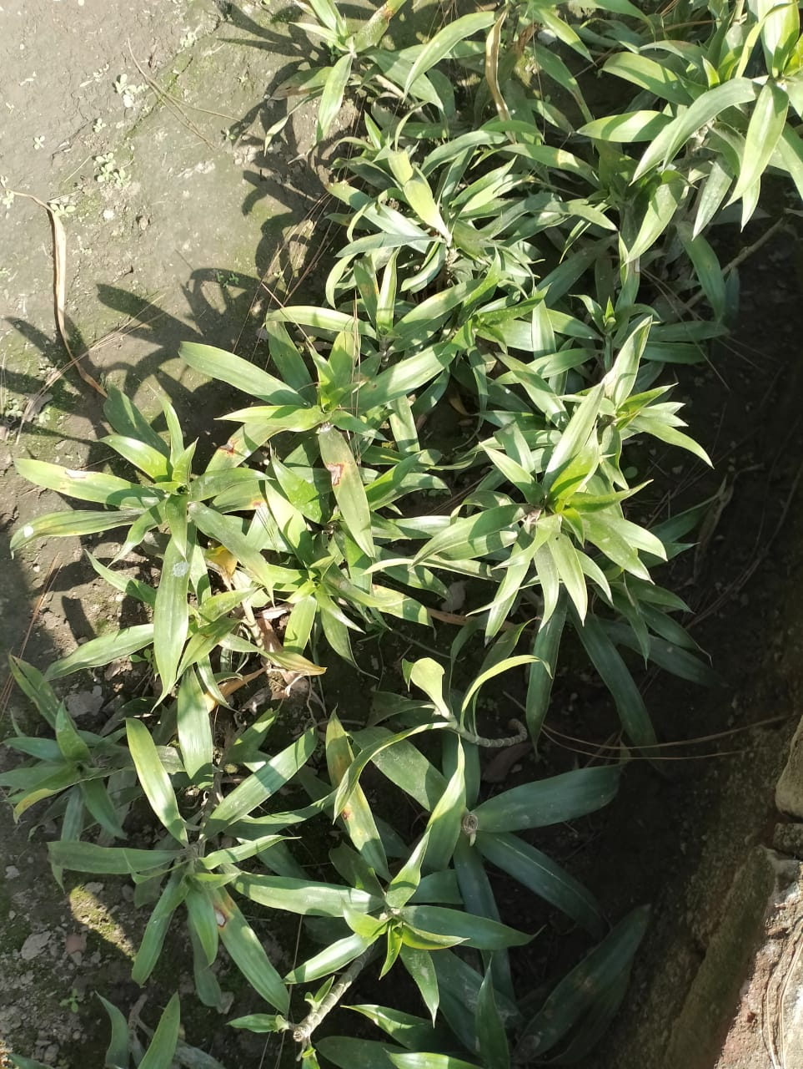
BOTANICAL NAME-
Tradescantia spathacea
COMMON NAME-
Moses-in-the-cradle
INTERESTING FACT-
Moses-in-the-Cradle, as an herbal plant, has been most widely used for domestic purposes, such as in medicinal diets in Vietnam for fighting against illnesses like coughs and other symptoms that are associated with bleeding.

Slide 48
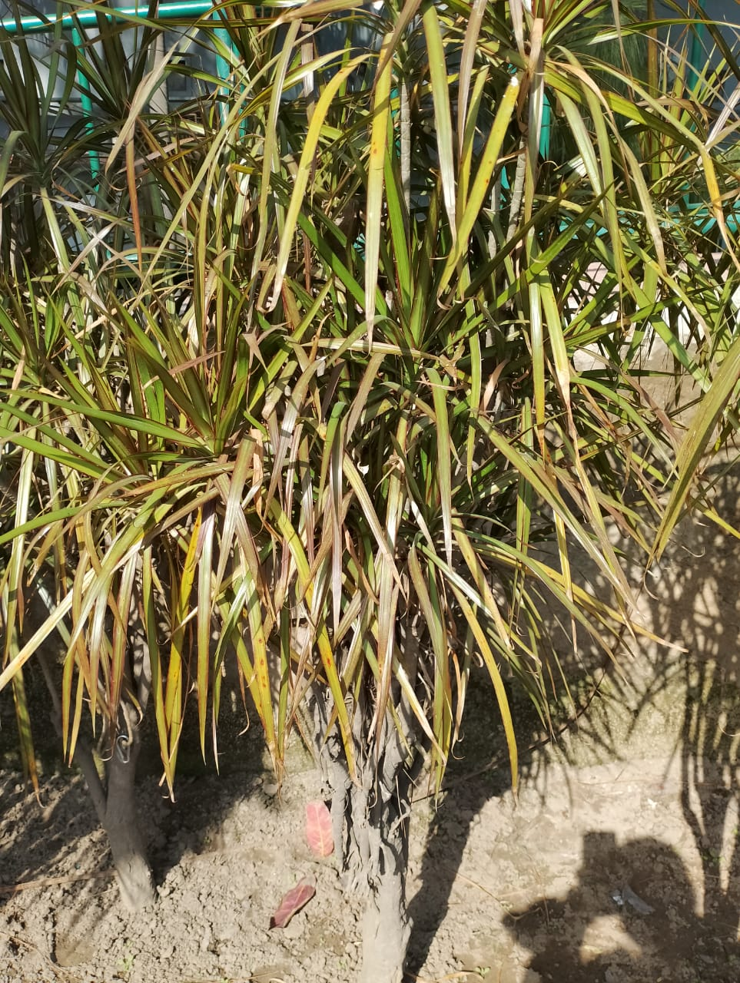
BOTANICAL NAME-
Dracaena angustifolia
COMMON NAME-
Narrow-Leaf Dragon Tree
INTERESTING FACT-
Narrow-Leaf Dragon Tree is native to East Himalaya, China, SE Asia and Australia. Flowering: March-May. Medicinal uses: The juice squeezed from the boiled leaves is drunk as a remedy for asthma and shortness of breath. A decoction of the leaves is given to people suffering weight loss and poor appetite.

Slide 49
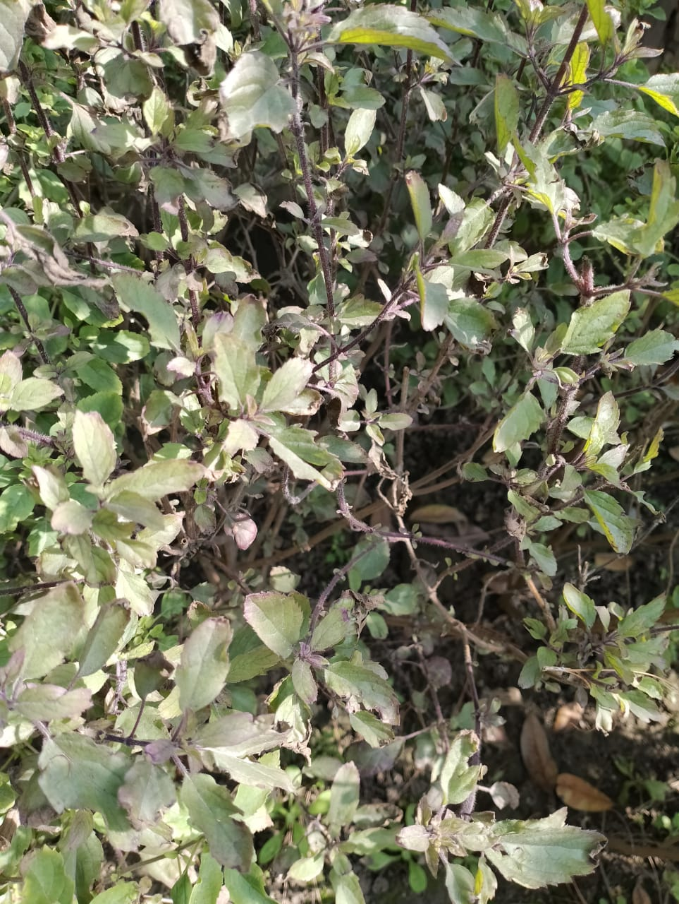
BOTANICAL NAME-
Ocimum tenuiflorum
COMMON NAME-
Tulsi
INTERESTING FACT-
Studies reveal that tulsi has a unique combination of actions that include: Antimicrobial (including antibacterial, antiviral, antifungal, antiprotozoal, antimalarial, anthelmintic), mosquito repellent, anti-diarrheal, anti-oxidant, anti-cataract, anti-inflammatory, chemopreventive, radioprotective

Slide 50
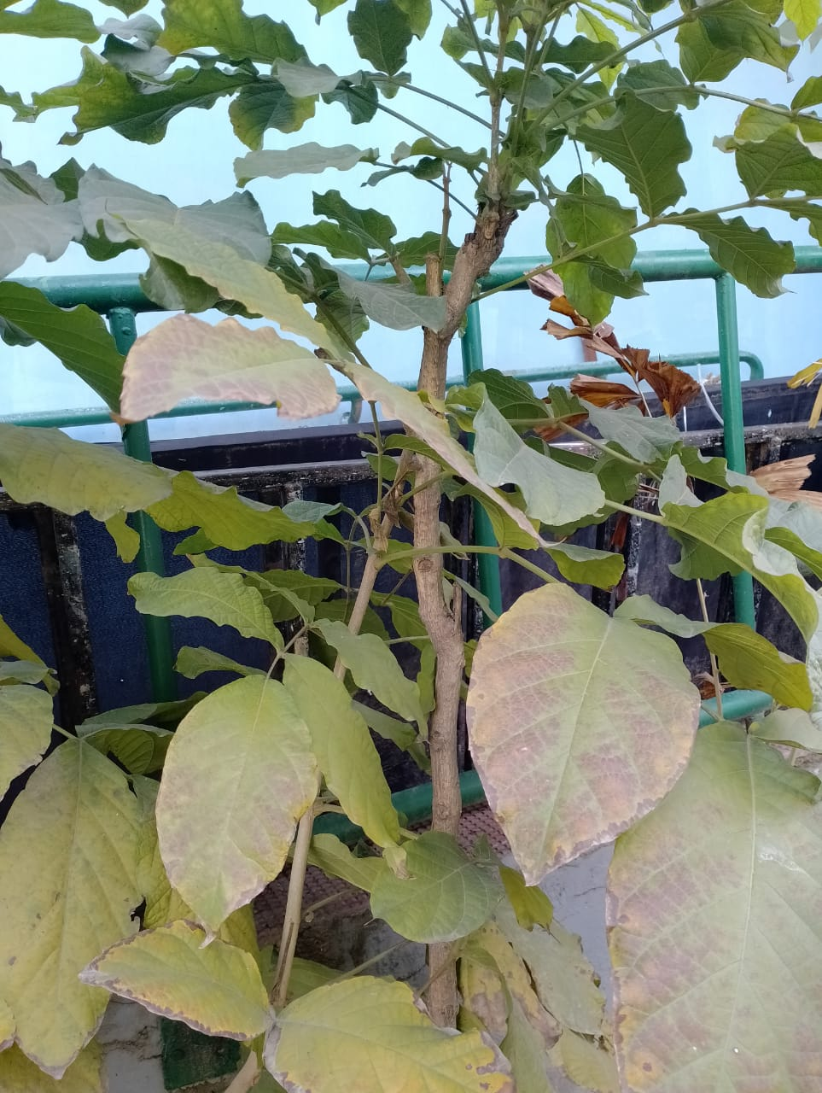
BOTANICAL NAME-
Tectona grandis
COMMON NAME-
Teak
INTERESTING FACT-
The plant has been used by traditional healers from time immemorial. Some of the mentioned traditional used in the literature are laxative, sedative, in treatment of piles, dysentery, leukoderma, anti-inflammatory, in bronchitis, urinary and liver related troubles, as hair promoter and useful in scabies.

