Slide 1
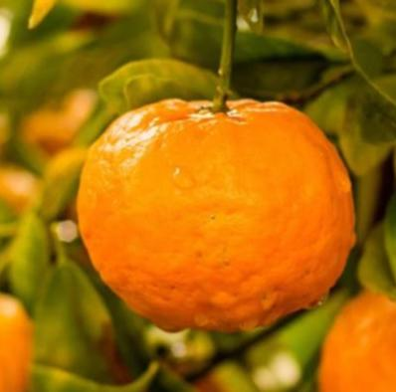
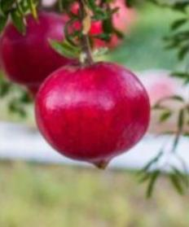
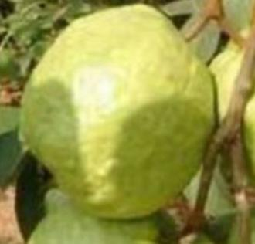
FRUITS
AT
JDMC

Slide 2
SCIENTIFIC NAME
Citrus reticulata
COMMON NAME
orange
INTERESTING FACTS
Oranges are truly an outstanding fruit. They are very healthy, cheap, and tasty, making them the ideal snack. In Texas, oranges are in season from
September to April.

Slide 3
SCIENTIFIC NAME
Artocarpus heterophyllus
COMMON NAME
Jackfruit
INTERESTING FACTS
Artocarpus heterophyllus Lam., which is commonly known as jackfruit is a tropical climacteric fruit, belonging to Moraceae family, is native to Western Ghats of India and common in Asia, Africa, and some regions in South America

Slide 4
SCIENTIFIC NAME
Mamey Sapote
COMMON NAME
Pouteria Sapote
INTERESTING FACTS
Pouteria sapota, the mamey sapote, is a species of tree native to Mexico and Central America. The tree is also cultivated in the Caribbean. Its fruit is eaten in many Latin American countries. The fruit is made into foods such as milkshakes and ice cream.

Slide 5
SCIENTIFIC NAME
Psidium Guajava
COMMON NAME
Guava
INTERESTING FACTS
Psidium guajava, the common guava,[2] yellow guava,[2] lemon guava,[2] or apple guava is an evergreen shrub or small tree native to the Caribbean, Central America and South America.[2] It is easily pollinated by insects; when cultivated, it is pollinated mainly by the common honey bee,
Apis mellifera.

Slide 6
SCIENTIFIC NAME
Citrus
COMMON NAME
Lemon
INTERESTING FACTS
The lemon (Citrus limon) is a species of small evergreen trees in the flowering plant family rutaceae, native to Asia, primarily northeast india (assam)northern Myanmar or China.

Slide 7
SCIENTIFIC NAME
Morus indica
COMMMON NAME
Shahtoot
INTERESTING FACTS
Shahtoot or Mulberry is a purple pink succulent fruit and can be found across India — from Karnataka, Andhra Pradesh to Himachal Pradesh and Punjab. The taste of each type may slightly vary from the other. This article curates Mulberry’s history, benefits and interesting facts related to it.

Slide 8
SCIENTIFIC NAME
Punica Granatum
COMMON NAME
Pomegranate
INTERESTING FACTS
The pomegranate is a fruit-bearing deciduous shrub in the family Lythraceae, subfamily Punicoideae, that grows between 5 and 10 m tall. The pomegranate
was originally described throughout the Mediterranean region

Slide 9
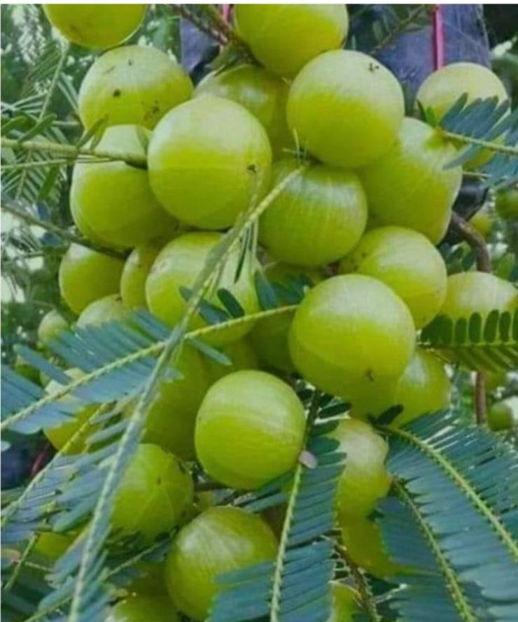
SCIENTIFIC NAME
Phyllanthus emblica
COMMON NAME
Amla
INTERESTING FACTS
Phyllanthus emblica, also known as emblic, emblic myrobalan, myrobalan, Indian gooseberry, Malacca tree, or amla, from the Sanskrit आमलकी, is a deciduous tree of the family Phyllanthaceae.
Its native range is tropical and southern Asia.

Slide 10
SCIENTIFIC NAME
Syzygium cumini
COMOOM NAME
JAMUN
INTERESTING FACTS
Syzygium cumini ,commonly known as jambolana, java plum, black plum or jamun is an evergreen tropical tree in theflowering plant family myrtaceae

Slide 11
SCIENTIFIC NAME
Carica Papaya
COMOOM NAME
Papaya
INTERESTING FACTS
The orange-yellow flesh of papaya
is rich in vitamins and fibers.
The tree starts bearing fruits
with in 9-12 month of planting.
it is recommended to harvest
it early as it starts yellowing,
eventually splitting open the fruit
.

